Slide 1
Checkpoints
Year 8 diagnostic mathematics activities
Understanding multiplicative relationships – percentages and proportionality
Twenty Checkpoints
Ten additional activities
Published in 2022/23

Slide 2
About this resource
This resource is designed to be used in the classroom with Year 8 students, although it may be useful for other students.
The Checkpoints are grouped around the key ideas in the core concept documents, 3.1 Understanding multiplicative relationships, part of the NCETM Secondary Mastery Professional Development materials.
Before each set of Checkpoints, context is explored, to help secondary teachers to understand where students may have encountered concepts in primary school.
The 10-minute Checkpoint tasks might be used as assessment activities, ahead of introducing concepts, to help teachers explore what students already know and identify gaps and misconceptions.
Each Checkpoint has an optional question marked . This will provide further thinking for those students who have completed the rest of the activities on the slide.
The notes for each Checkpoint give answers (if appropriate), some suggested questions and things to consider.
After each Checkpoint, a guidance slide explores suggested adaptations, potential misconceptions and follow-up tasks. These may include the additional activities at the end of this deck.

Slide 3
Checkpoints 1–10
Checkpoint | Underpins | Code
1: Shapes | Percentages | 3.1.5
2: Sponsored walk
3: Sponsored walk again
4: 110%
5: Percentage bars | Understand place value in decimals, including recognising exponent and fractional representations of the column headings | 1.1.1.2
6: Grids
7: 75%
8: Reasonable answers?
9: Attendance
10: In the sales
*This three-digit code refers to the statement of knowledge, skills and understanding in the NCETM’s Sample Key Stage 3 Curriculum Framework (see notes below for more information).
Notes:
In the Sample Key Stage 3 Curriculum Framework, statements of knowledge, skills and understanding are arranged to give an example teaching order. The three-digit code for each statement in the framework is a clickable hyperlink to documents with more detailed information, including the key ideas contained within that statement. These key ideas are also shown on slides 5–6 in this deck.

Slide 4
Checkpoints 11–20
Checkpoint | Underpins | Code
11: Fill in the gaps | Percentages | 3.1.5
12: Who do you agree with?
13: Savings
14: Ten percentimetres
15: Relative values | Understand place value in decimals, including recognising exponent and fractional representations of the column headings | 1.1.1.2
16: Noah fence | Proportionality | 3.1.2 3.1.6
17: Counters
18: Fallen arrows
19: Empty boxes | Understand place value in decimals, including recognising exponent and fractional representations of the column headings | 1.1.1.2
20: On target
*This three-digit code refers to the statement of knowledge, skills and understanding in the NCETM’s Sample Key Stage 3 Curriculum Framework (see notes below for more information).
Notes:
In the Sample Key Stage 3 Curriculum Framework, statements of knowledge, skills and understanding are arranged to give an example teaching order. The three-digit code for each statement in the framework is a clickable hyperlink to documents with more detailed information, including the key ideas contained within that statement. These key ideas are also shown on slides 5–6 in this deck.

Slide 5
Key ideas
Understand that multiplicative relationships can be represented in a number of ways and connect and move between those different representations | Code
Use a graph to represent a multiplicative relationship and connect to other known representations | 3.1.2.3
Use a scaling diagram to represent a multiplicative relationship and connect to other known representations | 3.1.2.4
Understand that percentages are an example of a multiplicative relationship and apply this understanding to a range of contexts | Code
Describe one number as a percentage of another | 3.1.5.1
Find a percentage of a quantity using a multiplier | 3.1.5.2
Calculate percentage changes (increases and decreases) | 3.1.5.3*
Calculate the original value, given the final value after a stated percentage increase or decrease | 3.1.5.4
Find the percentage increase or decrease, given start and finish quantities | 3.1.5.5
*‘There are additional resources exemplifying these key ideas in the Secondary Mastery Professional Development | NCETM.

Slide 6
Key ideas
Understand proportionality | Code
Understand the connection between multiplicative relationships and direct proportion | 3.1.6.1
Recognise direct proportion and use in a range of contexts including compound measures | 3.1.6.2
Recognise and use inverse proportionality in a range of contexts | 3.1.6.3
*‘There are additional resources exemplifying these key ideas in the Secondary Mastery Professional Development | NCETM.

Slide 7
Percentages
Checkpoints 1–15

Slide 8
Percentages
Previous learning
Key Stage 2 curriculum: Year 5: recognise the per cent symbol (%) and understand that per cent relates to ‘number of parts per hundred’ and write percentages as a fraction with a denominator 100 and as a decimal Year 5: solve problems which require knowing percentage and decimal equivalents of $\frac{1}{2}$, $\frac{1}{4}$, $\frac{1}{5}$, $\frac{2}{5}$, $\frac{4}{5}$ and those fractions with a denominator of a multiple of 10 or 25 Year 6: recall and use equivalences between simple fractions, decimals and percentages including in different contexts Year 6: solve problems involving the calculation of percentages [for example of measures such as 15% 0f 360] and the use of percentages for comparison Year 6 (non-statutory guidance): pupils link percentages of 360° to calculating angles of pie charts Further information about how students may have experienced this key idea in Key Stage 2: Teaching mathematics in primary schools, percentages are not mentioned in this document other than as future Key Stage 3 applications of Year 5 criteria (pp 208, 211 and 306)¹ Primary Mastery Professional Development, Spine 3 Fractions, Year 6 Segment 3.10 Linking fractions, decimals and percentages Key Stage 3 curriculum: 3.1.3.1² Finding a fraction of a given amount 3.1.3.2 Given a fraction and the result, find the original amount 3.1.3.3 Express one number as a fraction of another ¹ Page numbers reference the complete Years 1–6 document ² This four-digit code refers to the key ideas in Secondary Mastery Professional Development | NCETM; the Key Stage 2 content underpinning these ideas is assessed in the Understanding multiplicative relationships: fractions and ratio Checkpoints deck.

Slide 9
Percentages
In Key Stage 3 students need to
Connect fractions, percentages, proportionality and ratio together through the overarching idea of multiplicative relationships. Further develop their understanding of multiplication as scaling and not just as repeated addition, including in examples involving percentages. Continue to use informal additive methods to calculate percentages where appropriate. Understand that there exists a single multiplier linked to any percentage. Be able to work flexibly with percentages, recognising the most efficient strategy for the context of the calculation.

Slide 10
Checkpoint 1: Shapes
The images below show some parts of different shapes.
What might each whole shape look? Draw or describe them.
25%
25%
20%
60%
70%
5%
10%
150%
120%
Notes:
This slide is animated. Each shape will appear separately so you can choose the pace at which to work with your class. Printable versions are available on slides 73 and 74.
Answers
See the following slide for suggested answers for both the main task and further thinking question. These are not exhaustive: other shapes with the same area would also be valid.
Suggested questioning
Is your answer the same as or different from (for example, your partner’s)?
Can you think of an answer that no one else has?
Will the whole shape always be bigger than the part shapes? How do you know?
Things to think about
What shapes do you offer students to work with when looking at fractions and percentages? Students may want to complete this task by making familiar shapes such as circles or regular polygons. It may throw them, for example, that the quarter circle is only 10% of whatever shape they draw. Collect responses from students and consider how to check these. It’s perhaps unlikely that you’ll be able to ‘mark’ each answer. Rather, consider how to gain feedback about which shapes were the most challenging, and which instigated the most errors from your class.

Slide 11
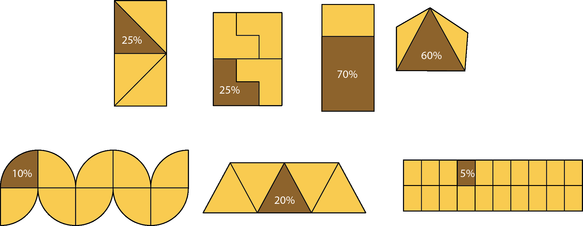
Checkpoint 1: Shapes (some possible solutions)

Slide 12
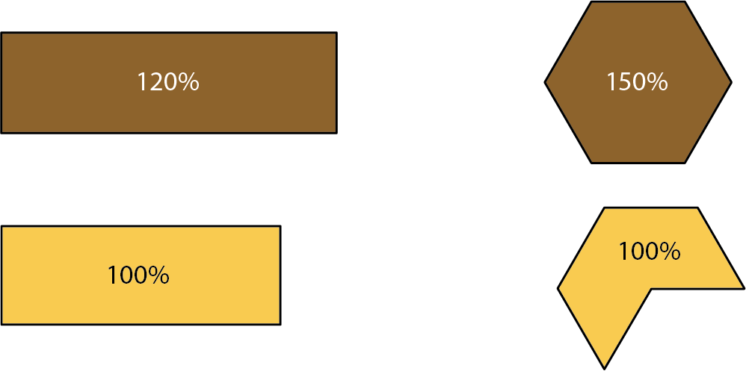
Checkpoint 1: Shapes (some possible solutions for the further thinking question)

Slide 13
Checkpoint 1: Guidance
Adaptations | Assessing understanding
Support Start by drawing a ‘whole’ and erasing 75% of the shape. Check that students understand that what’s left is 25% of the original. Then ask if it’s possible to say anything about how the original shape looked. Explain from the outset that there is more than one correct solution. Challenge Ask students to find three or four different possible ‘original’ shapes. Challenge students to work to an appropriate degree of accuracy. For example, with the third shape, the 70% rectangle, ask students to explain how they ensured that their ‘whole’ was in the correct proportion with the original 70%. Representations The representations in this task support students in visualising some of the discrete blocks they can use while working informally with percentages. You could also use tiles or blocks such as multilink cubes to support this. | This task shows how students work additively with percentages. The shapes are intended to be discrete ‘blocks’ that can be combined with others of the same type to make original shapes. Students’ accuracy and ways of approaching the different shapes may offer deeper insight into their understanding. Gather and compare different solutions to the same task – for example, for the first right-angled triangle, student solutions might include: Asking students whether all could be correct is likely to offer insight into their understanding of the ways that percentages can be manipulated. The further thinking question reveals whether students have previously encountered percentages greater than 100%.
Additional resources Additional activity E links percentages to decimals and fractions, which might be a helpful connection to make.

Slide 14
Checkpoint 2: Sponsored walk
Students in a school are doing a sponsored walk. Everyone walks the same distance at their own pace.
After one hour, Mo is 24% of the way through the walk. He has walked 3 600 m, so far.
Nick is 48% of the way through the walk. How far has Nick walked, so far?
Olga is 8% of the way through the walk. How far has Olga walked, so far?
How long is the sponsored walk?
Izzy walks twice as fast as Mo. How far has she walked when she’s 24% of the way through the walk? How long has it taken her?
Notes:
This slide is animated. Each question will appear separately so you can choose the pace at which to work with your class.
Answers
Nick has walked twice as far as Mo, 7200 m
Olga has walked one-third of the distance of Mo, 1200 m
15000 m
? Izzy has walked 3600 m in 30 minutes.
Suggested questioning
Can you think of a different way to work that out?
How can you use what you’ve already worked out to help you?
Things to think about
Multiple methods are likely to be used by students to work on this task – for some examples, see the Guidance slide. If you plan to use these methods as a discussion point with the class, think about which you’ll share, and which order you and the class will explore them in.

Slide 15
Checkpoint 2: Guidance
Adaptations | Assessing understanding
Support Use a number line to keep track of the distances and percentages of the. A double number line is particularly helpful for students familiar with this representation. Challenge Challenge students to find different ways to solve the problems, for example by asking students to find three different ways to calculate part c. Representations Use a double number line to help reveal the structure of the context for those students who are familiar with the representation. Similarly, a ratio table can help students recognise this as an example of a multiplicative relationship, and connect this context with other multiplicative situations. | As with Checkpoint 3 that follows, this task shows students’ understanding of manipulating percentages of amounts. However, it does not give the support of a representation. Students need to work with both the percentage and the numerical value associated with it. Notice if students reach for a representation to support them. Students who recognise the multiplicative relationships between the numbers given (i.e. that Nick’s distance is double Mo’s, and that Olga’s is one-third of Mo’s) are likely to be more fluent in their work with percentages. Strategies for part c are likely to be illuminating as students use different approaches. Compare these approaches (for example, by selecting three to be discussed on the board) to gain deeper insight into students’ understanding. Students who use sophisticated informal strategies (for example, doubling Nick’s distance and adding half of Olga’s, or halving Olga’s distance and multiplying by 25) may have a better understanding of percentages than a student who tries to work only with one value using a more formal method (for example, dividing 3600 by 24 and multiplying by 100).
Additional resources Checkpoints 3 and 5 also explore using a known percentage to find another percentage.

Slide 16
Checkpoint 3: Sponsored walk again
Three students use their sponsored walk to raise money for charity. They record on double number lines what they have raised so far against their target.
What was each person’s fundraising target?
Mo
Nick
Olga
Write some sentences to compare their fundraising targets.
Once the fundraising is complete, the three students raise a total of £3 000 between them. Sketch a double number line to show this compared with their combined total target.
Notes:
This slide is animated. Each question will appear separately so you can choose the pace at which to work with your class. A printable version of the number lines is on slide 75.
Answers
a) Mo: £900, Nick: £450, Olga: £600 (see the double number lines on the next slide).
b) There are multiple possible answers, and students’ responses will vary depending on their level of understanding (see the Guidance slide for more information). An example of a comparison of each possible pair of students is given below:
Mo’s target was 2 times greater than Nick’s.
Mo’s target was 1.5 times greater than Olga’s.
Nick’s target was half as great as Mo’s.
Nick’s target was three-quarters as great as Olga’s.
Olga’s target was $\frac{2}{3}$ as great as Mo’s.
Olga’s target was $\frac{4}{3}$ as great as Nick’s.
? See solutions slide that follows. The intention is to see a number line that identifies £1950 as 100%, and shows £3000 as just over 150%. Accuracy is not expected here (£3000 is in fact 153.8% of their target).
Suggested questioning
What other values can you work out?
Complete: “if I know __ I also know __, because __”
For which of these can you work out 100% in one step?
Which did you find hardest? Why?
Things to think about
Checkpoint 3 continues the context of Checkpoint 2 and is in many ways more straightforward as it uses simpler values and gives a representation to support students’ thinking. Why might you give an ‘easier’ task after a more challenging one? Perhaps you want to focus specifically on students’ understanding of and ways of working with a double number line? Perhaps you want to first see how they handle percentages without a visual, so you can assess the range of approaches they take? Regardless of the order you choose for these two similar Checkpoints, it is hoped that the differences between the tasks will provide useful assessment information.

Slide 17
Checkpoint 3: Sponsored walk again (solutions)
0%
100%
Mo
£0
£180
£900
0%
100%
Nick
£0
£180
£450
0%
100%
Olga
£0
£180
£600
0%
100%
150%
£0
£1950
£3000
Notes:
These double number lines represent solutions to part a and the further thinking question of Checkpoint 3.

Slide 18
Checkpoint 3 Guidance
Adaptations | Assessing understanding
Support Ask students to complete other values they know on the printable double number lines before seeking out 100%. Challenge The values offered are deliberately straightforward; offer more challenging reverse percentages. Can students identify the whole if 180 represents 45%? Or 12%? Representations The double number line can be a helpful representation for multiplicative relationships. Here it is used to support understanding of percentages, including over 100%. Further information can be found in Using mathematical representations at KS3 | NCETM. | Checkpoint 3 explores double number lines; use it to assess how familiar students are with this representation in the context of percentages, while also assessing their readiness to learn about ‘reverse percentages’ at Key Stage 3. The percentages and markings are straightforward to ensure the task is accessible. Students who are less confident might initially look for doubles and halves of the values given. The percentages (20%, 40% and 30%) have been chosen so that this strategy will not lead directly to an answer. For example, students might double 20% to find 40% and then double this to find 80%, but would then need to add their original 20% value on. This is less efficient but does demonstrate some multiplicative and additive reasoning. See how students work with this representation, and take time to collate and appreciate all the alternative strategies students offer. Look out for those students who immediately multiply Mo’s value by five as they are likely to be more fluent when working with percentages. Part b is open so that you can see what contributions students offer. Those most confident might be able to offer specific multipliers as suggested in the answers. Listen for those who can only offer vague statements such as ‘bigger’ and ‘smaller’ as they are likely to need more support to ‘see’ the mathematical relationships
Additional resources Key idea 3.1.2.1* from Secondary Mastery Professional Development | NCETM gives further ideas for ‘representing multiplicative relationships using double number lines’ at Key Stage 3

Slide 19
Checkpoint 4: 110%
Kathryn is an Olympic rower. Kathryn’s coach tells her she needs to give 110% effort in her race.
Is this possible? Why or why not?
Is 110% possible or not possible in each of these situations?
Scoring 110% on an exam.
Paying 110% of a debt back.
The cost of a house increasing by 110%.
A baby being 110% of its birth weight.
Being 110% older than when you started school.
Eating 110% of a cake.
Is it possible to decrease by 110% in any situation? Why or why not?
Notes:
This slide is animated. Each question, and each statement describing a situation, will appear separately so you can choose the pace at which to work with your class.
Answers
a) No, it is not possible: the most effort you can give is 100% (i.e. all of your effort) although it’s a common phrase used in sports coaching. What 100% effort looks like can, of course, vary each day.
b) Scoring 110% on an exam: not possible, as the maximum score is 100%.
Paying 110% of a debt back: possible. In fact, it is usual to pay back more than you borrowed in interest.
The cost of a house increasing by 110%: possible. If a house cost £200 000, then it would have increased by 110% if it was valued at £420 000. Note the phrasing here: if the statement said, ‘A house costing 110% of its original cost’, then it would be if it was valued at £220 000.
A baby gaining 110% of its birth weight: possible. If a baby weights 3 kg when it is born, then it will be 110% of its birth weight when it is 3.3 kg. Note the phrasing here: if the statement said, ‘A baby gaining 110% of its birth weight’, then it would be when it reached 6.3 kg.
Being 110% older than when you started school: possible. If you start school aged four then you’ll be 110% older when you are 8.4 years old. Note the phrasing here: if the statement said, ‘Being 110% of the age you were when you started school’, then it would be when you were 4.4 years old.
Eating 110% of a cake: not possible, as 100% would be all of the cake.
? This is only possible if a negative value makes sense in the context. For example, your bank balance can decrease by 110% if you have an overdraft.
Suggested questioning
What does 100% mean in this situation? Can you have more than that?
How might you represent this using a diagram?
Can you think of an example for this?
Things to think about
Many of the Checkpoints are discussion based, to learn about students’ understanding through their explanations and reasoning. Some of these situations may lead to disagreement! This is desirable, but think ahead about how to manage this in the classroom. Will you ask students to vote first? How will you ensure that students feel confident enough to give arguments and counter-arguments, even if they might ultimately be disproved? Will you ask students to vote again, to see if anyone has changed their mind? Activities like this are most effective within a classroom environment where all students’ voices can be heard, and where all students feel comfortable with being wrong.

Slide 20
Checkpoint 4 Guidance
Adaptations | Assessing understanding
Support Use a familiar representation such as a bar model, number line or double number line to help students to access the task. The representation may also help students to identify what the ‘whole’, or 100% looks like in each case, and so identify whether a greater figure is possible in that context. Challenge Ask students to think of their own situations where 110% is possible/not possible. Extend into even greater percentages – what does 500% mean? When might you see this? Representations A bar model can be helpful, particularly for identifying what 100% is in a given situation, and modelling 110% as 10% more. For the situations where 110% is possible, a continuous number line might be useful. A fixed shape such as a circle might be useful for representing the situations where it is not, for example a cake. | ‘Give 110%’, is a commonly used expression – often in the context of sports coaching. Often, this is refuted as not possible, without explaining why, or whether it might be meaningful in another context. This Checkpoint probes what 110% means and when it is possible. Students are likely to have only experienced percentages up to and including 100%. It is likely that they have done some percentage increase problems using an additive method, but that they won’t have associated a 10% increase with being 110% of the original value. This Checkpoint therefore is less about assessing students’ competence with percentage increase and more about probing their instincts about what 100% means in different contexts. Some will be less familiar than others – such as baby weights or house prices – but the situations as accessible yet authentic as possible. Learning more about how students visualise and understand percentages greater than 100% will help you gauge their readiness for developing percentages further at Key Stage 3.
Additional resources Key idea 3.1.5.3 from Secondary Mastery Professional Development | NCETM may give some ideas for where to take ‘calculating percentage changes’ next at Key Stage 3

Slide 21
Checkpoint 5: Percentage bars
Four friends live in different places. They draw percentage bars to show the percentage of days that they experienced different weather conditions.
Work out how many days were sunny, cloudy, rainy or stormy for each person.
a)
b)
A fifth friend wrote that it was sunny for two days and cloudy for eight, but forgot to write anything else down. Draw some possible bars.
c)
d)
Notes:
This slide is animated. Each question will appear separately so you can choose the pace at which to work with your class.
Answers
a) Sunny: 10 days, cloudy: 6 days, rainy: 4 days
b) Sunny: 20 days, cloudy: 10 days, rainy: 19 days, stormy: 1 day
c) Sunny: 20 days, cloudy: 12 days, rainy: 8 days
d) Sunny: 120 days; cloudy: 180 days, rainy: 80 days, stormy: 20 days
? Any bar where the cloudy section is four times as long as the sunny section, and the rest of the bars are in proportion. Some possible bars with integer solutions are shown on the next slide.
Suggested questioning
What is the same and what is different about the ‘20 days’ on each bar model?
How can you work out the missing percentage?
Which is the biggest section of the bar models? Which section represents the most days? Why are these not the same answer?
Things to think about
Bar models are a representation that is familiar from primary school and it is possible that students will be able to complete the ‘reverse percentage’ elements here without recognising them as such. Multiple methods are likely to be used by students. If you plan to use these methods as a discussion point with the class, think about which student methods you’ll share, and which order you and the class will explore them in.

Slide 22
Checkpoint 5: Percentage bars (possible solutions for further thinking question)
A fifth friend wrote that it was sunny for two days and cloudy for eight, but forgot to write anything else down. Draw some possible bars.
20% | 80%
10% | 40% | 50%
2% | 8% | 90%
15% | 60% | 25%

Slide 23
Checkpoint 5: Guidance
Adaptations | Assessing understanding
Support Break the task down further. Ask students to work out the missing percentage for each person, then to work out the number of days for one particular weather types for each person. Challenge Remove the references to 20 days on each bar model; ask students what values are possible. Representations Bar models are a helpful representation for fractions, percentages and ratio. Here, the length of the bars is constant but what each bar/part represent is varied. Do students recognise that 100% has a different value in each case? Further information can be found in the NCETM’s guidance Using mathematical representations at KS3 | NCETM. | There are a number of assessment points in Checkpoint 5. The values involved are relatively straightforward so that the numbers are not a barrier, allowing you to work out if there are any issues with understanding. Students need to understand: The whole bar totals 100% and find the missing percentages in each bar. Which part of the bar is indicated by the value 20 (for example, in part a this is 100%, while in part b it is 20%) and how to use this to work out the value of other parts of the bar, including simple reverse percentages. Identifying which, if any, elements of this cause difficulty will help you to plan for teaching of percentages at Key Stage 3. Listen carefully to students’ reasoning and identify if there are any gaps in their understanding. For example, for part b, students might halve 20 to find 20%, recognising that 40% is double 20%. This is sound reasoning, but if they do not then have a strategy to find the other percentages, they need more work on finding and working between percentages. Similarly, if students always rely on finding 1% but don’t spot efficiencies (such as finding 10% to work out 20% and 30% in part c) then their fluency with percentages could be further developed.
Additional resources Segment 3.10 of Primary Mastery Professional Development | NCETM demonstrates how students might have experienced the idea of linking fractions, decimals and percentages, including the representations they may have experienced.

Slide 24
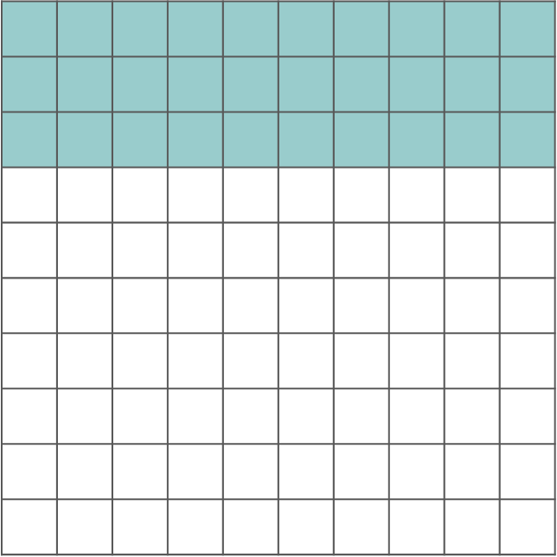
Checkpoint 6: Grids
What percentage is shaded on the 100 grid on the right?
Shade the same percentage on grids A to I.
G
A
B
C
F
D
H
E
I
Draw grids with different numbers of sections. How many are needed to shade the same percentage each time?
Notes:
This slide is animated. Each question will appear separately so you can choose the pace at which to work with your class. To shade the grids, students will need the printable version on slide 76.
Answers
a) 30%
b) See the following two slides for some suggestions of what the shading might look like. The actual sections that students shade may vary, but they need to be the equivalent of:
A 15 sections
B 3 sections
C 12 sections
D 3 sections
E 6 sections
F 15 sections
G 0.6 sections
H 1.5 sections
I 1.2 sections
? Students’ responses will vary.
Suggested questioning
What’s the same and what’s different between these grids __ and __?
Can you use any of your other answers to help you?
Does writing the percentage as a fraction or a decimal help with the task?
Things to think about
What shapes do you offer students to work with when looking at fractions and percentages? Often the grids used contain a ‘friendly’ number of cells. In this task, students may use previous grids to help with the next. For example, since the original 100 square and shape G align, extending the shaded area from the hundred square to G will shade the required 30%. Similarly, a vertical line can be drawn straight through shapes C, D and E to show 30%. This method may not be intuitive to many students. Consider how to explore and develop this in advance of the lesson. Perhaps offer this to colleagues, and see the different ways that they shade the shapes – you may be surprised! Think in advance about how you will go about collecting responses from students and how to check these. It’s unlikely that you’ll be able to mark each grid from each student; instead consider how to gain feedback about which grids were the most challenging, and which instigated the most errors.

Slide 25
Checkpoint 6: Grids (some possible solutions)
What percentage is shaded on the 100 grid on the right?
30%
Shade the same percentage on grids A to I.
G
A
B
C
F
D
H
E
I
Notes:
This slide is animated. An example solution will appear separately for each grid so you can choose the pace at which to work with your class.

Slide 26
Checkpoint 6: Grids (more possible solutions)
What percentage is shaded on the 100 grid on the right?
30%
Shade the same percentage on grids A to I.
G
A
B
C
F
D
H
E
I
Notes:
This slide is animated. An example solution will appear separately for each grid so you can choose the pace at which to work with your class.

Slide 27
Checkpoint 6: Guidance
Adaptations | Assessing understanding
Support Start with 50% rather than 30%, or offer students fewer grids using Additional activity B. Challenge Ask students to work on one grid and to shade 30% in as many ways as possible, then to compare the different shading methods for accuracy. Does it matter if the shading isn’t in a single block? Can the sections shaded be spread across the shape? You might also ask students what would happen if two or three of the grids were connected – what percentage of the whole would then be shaded? Representations The hundred grid is a helpful representation for percentages. Ask students to state the value of the whole and then what each part represents. | Checkpoint 6 explores different representations of the same percentage on a hundred grid and then grids with different numbers of squares. Consider how they students work with these. Do they think about each smaller division, and what percentage this represents? Do they use equivalent fractions? The context of shading shapes will be familiar as a way of thinking about fractions. Students are likely to give insight into their understanding of the connections between percentages and equivalent fractions as they answer some of the problems. In others (particularly D, G and I) students might use known facts such as 25% is $\frac{1}{4}$ to shade the grid. Note the connections between the grids, sometimes emphasised by the alignment of the divisions – students might draw lines between them on the printable version. Shapes A and B are the same ‘whole’, divided into different sized sections. Shapes C, D and E, although different heights, have the same length, so this can be considered as the whole. Shape G is the same height as the 100 square and the shading from the square can be extended across. Students who work with these connections, or explain them when prompted, are likely to have a good understanding of proportionality and percentages.
Additional resources Additional activity A is a blank version of this task so that you can explore with percentages other than 30%, and Additional activity B is an easier version with fewer grids. Additional activity D takes the idea of representing percentages on a grid even further.

Slide 28
Checkpoint 7: 75%
On the right are six students’ different strategies for finding 75% of 250. One of them is incorrect.
Whose strategy is incorrect?
Put the correct strategies in order of which you prefer to use.
Abdul
250 ÷ 100 = 2.5
2.5 × 75 = __
Beth
250 ÷ 2 = 125
125 ÷ 2 = 62.5
125 + 62.5 = __
Caris
250 ÷ 10 = 25
25 × 7 = 175
25÷ 2 = 12.5
175 + 12.5 = __
Darren
250 ÷ 4 = 62.5
250 − 62.5 = __
Eden
250 ÷ 4 = 62.5
62.5 × 3 = __
Faaris
250 ÷ 75 = __
How could you adapt each method to find 90% of 250?
Are there any that can’t work for this percentage?
Notes:
This slide is animated. Parts a and b and the further thinking question will appear separately so you can choose the pace at which to work with your class.
Answers
a) Farris: 250 ÷ 75 is incorrect.
b) Students’ answers will vary, depending on their own personal experience and preference. See Things to think about.
? Alterations are in bold below.
Abdul: 250 ÷ 100 = 2.5, 2.5 × 90 = __
Beth: 250 ÷ 2 = 125, 125 ÷ 5 = 25, 125 + 25 + 25 + 25 + 25 = __
Caris: 250 ÷ 10 = 25, 25 × 9 = __
Darren: 250 ÷ 10 = 25, 250 − 25 = __
Eden: same as Caris.
Suggested questioning
Can you draw a picture to show why one works/doesn’t work?
What’s the same about all of the correct methods? What do they have in common?
Things to think about
One of the great challenges with teaching multiplicative structures such as percentages is the decision about which approach to take. You might, for example, find different teachers have different opinions about whether it is best to teach a single method that can be applied to any situation (such as a unitary method); to teach multiple methods; or to allow students to find their own methods based on an understanding of the mathematical structure. Discuss the different strategies from Checkpoint 7 with colleagues. Do you all share a common approach? How do you encourage a deep and connected understanding with your students?

Slide 29
Checkpoint 7: Guidance
Adaptations | Assessing understanding
Support It can be challenging to take in so many calculations at once. Pick three or four (including the incorrect one) and write them up on the board ‘live’ so that students see the calculation build. Challenge Ask students to suggest their own methods for a percentage calculation, giving specific categories, such as most efficient or most imaginative. Representations A bar model is a useful way to compare all of the methods. Show the different ways to split 250 and then build up to 75%. | The range of prior mathematical experience that students bring can be particularly evident in multiplicative relationships such as percentages. Checkpoint 7 explores these different approaches so that you can assess how flexibly students think about percentages. Students first need to identify the incorrect method – dividing the whole by the percentage that you are trying to find. This misconception can arise when students overapply the ‘divide by 10’ method for finding 10%. Part b asks students to order the rest of the calculations according to preference. There are no right answers. Some students might not choose to use any of the suggested calculations – in this case, encourage them to add their own methods to the group and see where the rest of the class place these new methods in their own orders. Discuss efficiency: is the method that students choose the most efficient way to find that particular percentage? If so, will it be the most efficient way to find any percentage? Exploring some different methods will enable you to assess students’ fluency and reasoning with percentages. Are they reliant on a single method, or can they appreciate why all of the first five strategies are correct? Those who use a rigid set of steps to find percentages may struggle to connect these ideas to the many applications of percentages at Key Stage 3. Spend some time thinking deeply about the structure of percentages with these students.
Additional resources Page 20 of the Year 5 and p26 of the Year 6 Primary Assessment Materials | NCETM both ask about finding percentages.

Slide 30
Checkpoint 8: Reasonable answers?
Chris’s answers to his maths homework will appear on the right.
Without calculating, decide if they are reasonable answers or not.
10% of 350 is 3.5
1% of 3500 is 0.35
5% of 720 is 144
33% of 720 is 360
2% of 90 is 18
90% of 630 is 7
For the answers that you think were not reasonable, find the correct answers. What is the most efficient way to do this?
Notes:
This slide is animated. Each question in the ‘maths homework’ and the further thinking question will appear separately so you can choose the pace at which to work with your class. Printable blank hundred grids, which may be a useful representation for modelling these calculations, can be found on slide 72.
Answers
None of the answers are reasonable. Some suggested justifications are given below – these will not be exhaustive. Remember, students are asked not to calculate, so their justifications may not involve the ‘right’ answers (see the answers to the further thinking question).
a) This value is too small, as 3.5 is 100 times smaller than 35, not 10 times smaller.
b) This value is too small, as 0.35 is 1000 times smaller than 3500, not 100 times smaller. Students might also compare to the answer to a, recognising that 0.35 is the wrong order of magnitude.
c) This value is far too big. Students might estimate that it needs to be under 50, or that it should be half of 10% (which is 72). In fact, 5% of 720 is 36 and 144 is one-fifth (or 20%) of 720.
d) The value is too big: 360 is half of 720, so 33% needs to be smaller than 360.
e) This value is too big: 1% of 90 is 0.9 (students might say ‘just under one’), so 2% will only be twice this (students might say ‘just under two’).
f) This value is far too small: 90% is nearly 100%, so the number needs to be just under 630.
? a) 10% of 350 is 35
b) 1% of 3500 is 35
c) 5% of 720 is 144
d) 33% of 720 is 129.6
e) 2% of 90 is 1.8
f) 90% of 630 is 567
Suggested questioning
What are the first things you’re looking for?
Which did you decide were not correct first? What made it obvious that they were wrong?
Things to think about
This Checkpoint is discussion-based, to help you to investigate students’ understanding through their explanations and reasoning. It may lead to disagreement. This is desirable, but think ahead about how to manage this in the classroom. Will you ask students to vote first? How will you ensure that students feel confident enough to give arguments and counter-arguments, even if they might ultimately be disproved? Will you ask students to vote again, to see if anyone has changed their mind? Activities like this are most effective in a classroom environment where all students’ voices can be heard, and where all students feel comfortable with being wrong.

Slide 31
Checkpoint 8: Guidance
Adaptations | Assessing understanding
Support The intention of this task is to hear how students reason. Use a familiar representation (see below) to support them in making their thinking visible. Challenge Ask students to write percentage questions that lead to the incorrect answers given. Representations A sense of scale is important here, and so a number line is a useful representation. It could be used alongside a bar model. Place a bar that has been split into 10 parts along the line, so that students can see whether the value that is given is reasonable. A hundred grid is also a valuable representation. For example, for part a, ask students what the value of 1 square (1%) would be if the whole grid represents 350 and whether the answer given is reasonable for 10 squares (10%). A blank hundred grid can also be found in printable resources. | Being able to estimate a reasonable answer s a an important aspect of being fluent in calculation. This is particularly the case with percentages, where an answer might have the correct digits but be of the wrong order of magnitude – for example, confusing 1% with 10%. Some of the incorrect answers are based on common misconceptions – part c, for example, confuses finding 5% and finding 20% by dividing by five. The focus is less on why these wrong answers have been achieved and more on whether students can recognise them as likely to be wrong. Listen to students’ reasoning and, if they are reliant on giving the right answer as their justification, encourage them to think of other ways to explain themselves. Are they able to estimate approximately how big the answer should be? Can they use key reference points, such as 50%, to compare with the incorrect answer? Do they recognise the connections between some of the questions such as parts a and b) and use these to support their reasoning?
Additional resources Examples of questions on finding percentages can be found in the Year 6 SATs papers (such as question 18 of 2018 Paper 3 reasoning). Past papers can readily be found online. Additional activity C could be used if students need more time to find and reason with percentages of a quantity.

Slide 32
Checkpoint 9: Attendance
Jasmine is ill and misses her first day of school.
What is her percentage attendance after day one?
Jasmine is better the next day and attends school.
What is her percentage attendance after day two?
Jasmine attends the rest of that week and all of the next week.
What is her percentage attendance after day five?
What is her percentage attendance after day ten?
Jasmine says that she will need to attend every day for the rest of the year to get 100% attendance.
Is Jasmine correct? Why or why not?
There are 190 days in the academic year. What is the highest Jasmine’s percentage attendance can be? What is the lowest?
Notes:
This slide is animated. Each statement and question will appear separately so you can choose the pace at which to work with your class. Printable blank hundred grids, which may be a useful representation for modelling these calculations, can be found on page 72.
Answers
a) 0%
b) 50%
c) 80%
d) 90%
e) No, Jasmine is not correct – she cannot get 100% attendance for the year, as she has already missed a day.
? The highest Jasmine’s attendance can be is 99% (as 189 $÷$ 190 $×$ 100 = 99.473684…). The lowest Jasmine’s attendance could be is 5% (as 9$÷$ 190 $×$ 100 = 0.04736842…)
Suggested questioning
Is it possible for Jasmine to have 90% attendance in the first week? The first term?
How does the calculation to work out Jasmine’s attendance percentage change each day?
Things to think about
Be sensitive to any attendance issues with students in your class before using this context. It was chosen due to its familiarity, but if it is likely to be problematic, then the same structure can be used in the context of tests with different numbers of questions, the student always getting the first question wrong. This set of questions may challenge students’ intuitive responses. The sense that some days are ‘worth more’ than others (in the first week of term, each day is a significantly greater percentage of the year so far than at the end of term) provides an interesting discussion point.

Slide 33
Checkpoint 9: Guidance
Adaptations | Assessing understanding
Support If students find it hard to think in terms of percentages, use the same structure but ask what fraction of the total number of school days Jasmine has attended each time. This will help you understand whether students know how to express quantities as fractions when the whole changes, and therefore whether they are ready to apply that understanding to percentages. Challenge Ask students to estimate Jasmine’s attendance percentage after a number of days close to a factor of 100, such as after 51 or 99 days. Representations Use a hundred grid, such as this printable one. Model how the whole grid represents one day after part a (so each day is 100 squares), two days after part b (so each day is 50 squares), five days after part c (so each day is 20 squares) and so on. Ask how many days would need to go by for two squares to represent one day. | Attendance percentages are likely to be familiar to students, and this Checkpoint uncovers potential misconceptions. Students are stepped through so that you can spot at which stage any problems occur. Note the strategies that students choose, as this will give you insight into how they think about percentages. Do they use the same strategy each time? Do they use informal reasoning for part b and, if so, can they continue to do this for the remaining parts? Each time, the total number of days remains a factor of 100, so it is possible to use equivalent fractions as a strategy. Draw out whether students like to think about Jasmine’s total days attended as a percentage each time, or if they consider her single day of absence and what this is worth as a percentage as the days increase and then subtract it from 100%. Part e addresses a very common misconception, which can be exacerbated by statements around attendance, such as ‘Aiming for 100%’. Do students recognise that 100% is not possible as soon as there is any day of absence? Talk about 100% and what it means.
Additional resources Additional activity C features a hundred grid where you can vary the value of 100%, which builds nicely from this task.

Slide 34
Checkpoint 10: In the sales
Orla has £20 to buy a present for her dad. There is a sale on at the shop.
Below are some items with their original prices and the discounts to be applied.
Which of the items can she afford?
Shorts, £30
Jacket, £50
T-shirt, £25
Hat, £22
Scarf, £24
10% off
50% off
20% off
25% off
15% off
For those she can’t afford, what discounts would she need so that she can afford any item in the shop?
Notes:
This slide is animated. Each item, and then the further thinking question, will appear separately so you can choose the pace at which to work with your class. Printable blank hundred grids, which may be a useful representation for modelling these calculations, can be found on page 72.
Answers
Orla can afford the T-shirt or the hat.
? Orla would need these discounts:
Shorts: a minimum of a 33.33% (2 d.p.) discount (or $\frac{1}{3}$).
Jacket: a minimum of 60% discount.
Scarf: a minimum of 16.67% (2 d.p.) discount (or $\frac{1}{6}$).
Suggested questioning
Which is the easiest percentage to work out?
Can you use any of the values you’ve already calculated to help answer another question?
Can you find another way to work out the answer? Is your method the same as the person sitting next to you? Which is more efficient?
Things to think about
Multiple methods are likely to be used by students as they work on this task. If you plan to use these methods as a discussion point with the class, think about which student methods you’ll share, and which order you and the class will explore them in. Some students may choose to estimate rather than formally working out the percentage each time. If done well, this might be indicative of some stronger mathematical thinking with percentages. Look also for those students who can move fluently between percentages and fractions to support efficiency.

Slide 35
Checkpoint 10: Guidance
Adaptations | Assessing understanding
Support Connecting this task with Checkpoint 8, where estimates are considered, might help students to access the questions. Ask whether there are any items that we know Orla can’t afford before doing any calculations to make the task more manageable. This will offer insight into students’ understanding. You could also support students to construct a ‘ready reckoner’ that shows the same percentage off different prices to support with this sense of estimation. Challenge Work in reverse: give students an amount (such as Orla’s £20) and ask them to suggest original prices with percentage discounts that would make them affordable. What is the biggest original amount they suggest? What discount does it need? Representations A bar model or number line is helpful for percentage changes. You might also use a hundred grid to model the discount. | Finding simple percentage increase or decrease is within the scope of the primary curriculum, and Checkpoint 10 checks students’ retention of this. It is likely that students will use a strategy of finding the percentage and subtracting from the original 100%. The values given are straightforward: look out for whether students come unstuck where the answer is decimal (a hat) or where it is not possible to use a single divisive step to find the discount (a jacket). Students might use reasoning for some answers rather than finding the percentage given. For example, they might identify that a 20% discount for the jacket would be £4.80 and reason that 15% would therefore not be enough discount for the item to be affordable. This indicates a stronger number sense and understanding of proportion.
Additional resources Key idea 3.1.5.3 from Secondary Mastery Professional Development | NCETM may give some ideas for where to take calculating percentage changes next at Key Stage 3 An example of a percentage discount question can be found in the 2022 Key Stage 2 SATs papers (question 18 of Paper 3 Reasoning); past papers can readily be found online. Teaching Point 6.14, Segment 3.10 of Primary Mastery Professional Development | NCETM looks at percentage reduction.

Slide 36
Checkpoint 11: Fill in the gaps
Use the values below to fill in the gaps.
You can only use each value once – there will be one left over.
5
500
__ % of __ is __.
__ % of __ is __.
__ % of __ is __.
2
50
250
20
250
25
250
1000
Use the leftover number to create some sentences in the same format. How can you use it in your first gap? What about the second? The third?
Notes:
This slide is animated. The further thinking question will appear separately so you can choose the pace at which to work with your class.
Answers
2% of 250 is 5 (or 250% of 2 is 5).
20% of 250 is 50 (or 250% of 20 is 50).
25% of 1000 is 250 (or 1000% of 25 is 250).
Leftover value: 500
? There are multiple solutions, but here are some examples where 500 is in each space:
500% of 50 is 250
50% of 500 is 250
50% of 1000 is 500
Suggested questioning
What’s a good starting point to solve the problem?
Are there any cards that must go together? Are there any that can’t go together? How do you know?
Things to think about
Students may be keen to complete the task by solving the puzzle. While this resilience is to be encouraged, think about how/whether to move students on once the key assessment point has been addressed. What is the focus of the task for you and for your class? Do you want to allow sufficient time for the puzzle to be fully completed, or will you be happy to move on once you have established whether students have a sound understanding of the percentage statements? If the latter, then students may generate a number of correct statements that do not include the ones needed for the puzzle.

Slide 37
Checkpoint 11: Guidance
Adaptations | Assessing understanding
Support Ask students to notice that there are three 250s: can they place these first? Alternatively, remove the challenge of making three calculations with just one card left. Instead, ask students to make as many calculations as they can using the given values. This is explored in Additional activity G. Challenge Encourage students to think of solutions involving percentages greater than 100. Say, ‘Becky thinks 250% of 2 is 5 is a possible solution’, and discuss whether or not they think Becky is correct. Representations Use a double number line to help students work with the structure of percentages and calculate percentages of amounts. Bar models are also a useful representation. | Assess students’ familiarity with finding percentages of amounts. Some more confident students may be able to estimate whether a result ‘feels’ correct without calculating, or reject certain combinations as impossible. Those who are less secure may struggle to write the statements without working out the percentages using a more formal method first. The values have been selected so that some common misconceptions may be revealed. For example, students may offer that 5% of 250 is 50, dividing by 5 to find 5%. The intention is to reveal understanding rather than complete the task. Students may construct a number of correct statements but not create the arrangement that allows all of the gaps to be filled. It is perhaps unlikely, but students familiar with percentages greater than 100% may use commutativity to create a set of correct statements such as 250% of 2 is 5; you might wish to prompt students to do this if you feel they are ready (see ‘Challenge’).
Additional resources Additional activity G is a different, more accessible version of the same task, asking students to write as many statements as possible rather than aiming for a particular arrangement.

Slide 38
Checkpoint 12: Who do you agree with?
Who do you think is correct? Why?
Finding 20% of a number is easy. You just divide it by 20.
Finding 10% of a number is easy. You just divide it by 10.
Bryn
Finding 50% of a number is easy. You just divide it by 50.
Arne
Cho
What percentages would Bryn’s calculation actually find? How about Cho’s?
Notes:
This slide is animated. The further thinking question will appear separately so you can choose the pace at which to work with your class; do not reveal this until after students have had some time to consider the main task, as it reveals the answer. Printable blank hundred grids, which may be a useful representation for modelling these calculations, can be found on page 72.
Answers
Arne is correct. Bryn and Cho are not correct. Students’ reasoning may vary. They might suggest that Bryn and Cho’s answers will be too big or offer correct methods instead (20% would be divide by five and 50% would be divide by two). Students may also try to exemplify their reasoning using a particular value, showing why dividing it by 20 would not result in 20% of that number.
? Bryn found 5% and Cho found 2%.
Suggested questioning
Do you have an easy way to find 50%? How do you think about it?
How about 20%?
Are there any other percentages that you have an easy way to calculate?
Things to think about
This Checkpoint may raise a misconception. Think about how to set up the task such that students are comfortable and willing to share their thinking openly with others.
Should this misconception be shared by students, think about when to address this. It may not be best to address it immediately, rather to plan some lessons or lesson tasks that build to this. Students may be more willing to change their mind about a concept after multiple experiences rather than just being ‘shown’ that their method isn’t correct.

Slide 39
Checkpoint 12: Guidance
Adaptations | Assessing understanding
Support Finding 10%, 20% and 50% for a particular value, and using this as a platform to reason from may help students access the task and move towards a generalisation. Challenge Tell the students that Arne, Bryn and Cho each have £30 in their pocket and that this is 10% of Arne’s total money, 20% of Bryn’s total and 50% of Cho’s total. How much do Arne, Bryn and Cho have each? Representations Use a bar model to compare the relative sizes. For example, create the bar model by counting up in 20% sections to show that 20% is $\frac{1}{5}$ of the whole, rather than $\frac{1}{20}$. Modelling splitting a hundred grid into the divisions described can also help dispel misconceptions. | Checkpoint 12 tackles a common misconception, the over-application of dividing by 10 to find 10% of any number. The prompts are simple to leave the task open to students’ own choice of reasoning in response. Do they correctly identify a method for finding the percentage? Do they identify what actual percentage the method given finds? Or do they find it easier to model using a particular value? Students’ justifications are likely to reveal a lot about how they think about fractions, which is useful for planning how to revisit prior learning and teach new concepts. Any students who agree with all three speech bubbles are likely to need significant support to understand percentages as a representation of proportion. Both 20% and 50% are included, partly to emphasise the point, and also because 50% offers an easier example for students to reason with. It is likely that students are more confident and familiar with 50% being equivalent to a half, and a half being found by dividing by two. For this reason, it is offered after 20%, so that you can see if any students struggle to reason with that first.
Additional resources Segment 3.10 of Primary Mastery Professional Development | NCETM demonstrates how students might have experienced the idea of Linking fractions, decimals and percentages, particularly Teaching Point 6.

Slide 40
Checkpoint 13: Savings
Kaylita and Patrick each save a different percentage of their earnings.
Kaylita saves 5%. Patrick saves 10%.
Who saves more?
Kaylita is paid £4 000 per month. Patrick is paid £1 500 per month.
Does this change your answer to part a?
Patrick has a pay rise to £1 800 per month.
Does he save more than Kaylita now? Why or why not?
Kaylita and Patrick now decide that they both want to save the same amount each month. What would need to change?
Notes:
This slide is animated. Each question will appear separately so you can choose the pace at which to work with your class. You will need to show this slide in present/slideshow mode so that the animations for parts b and c do not influence students’ thinking for the previous parts.
Answers
a) We do not know who saves more in terms of actual money. Patrick saves a greater proportion of his earnings.
b) If students suggested Patrick saves more, or that we do not know, then yes it does change the answer to part a. We now know that Patrick saves £150 and Kaylita saves £200. So, although Kaylita saves a smaller proportion of her earnings, she saves more actual money.
c) No, Patrick still does not save more than Kaylita. He needs to save a greater percentage of his salary, or to earn more than £2000 if he still wants to save 10%.
? There a multiple ways to answer this question. Using the earnings in part c, Kaylita could decrease her savings to 4.5%, if Patrick kept his at 10%; or Patrick could increase his savings to just over 11.1%, if Kaylita kept hers at 5%. This answer is perhaps less likely if students are working without calculators. Alternatively, they could continue to save the same percentages, but either Kaylita would need to reduce her earnings to £3600 or Patrick increase his to £2000.
Suggested questioning
What’s your instinct about the answer to this?
How did you calculate the different percentages? Did you use the same method to calculate both?
Can you draw a diagram or graph to help show the way that the values change?
Things to think about
Part a is deliberately ambiguous – think about how you will manage questions about this without rushing to part b. The questions from students are likely to inform your assessment of their understanding. Explore the methods used by students to calculate the amount saved – flexibility in thinking is a key element of fluency, and students might choose different methods for the different values in the task. Consider whether discussing these methods is a useful focus when you use this task.

Slide 41
Checkpoint 13: Guidance
Adaptations | Assessing understanding
Support Offer an additive element to the question to help students access the task. For example, ask whether saving £10 per month is more or less than saving 10% to start a discussion around ‘it depends’, which can then be explored further using the context from the slide. Challenge Ask students to consider the situation where both Kaylita and Patrick get a further £200 pay rise, but both decide to keep paying the same amount into savings. Without calculating, can they reason about whether the percentage that’s being saved has increased or decreased? Which person has changed their percentage most? Representations The use of a number line or a double number line can be helpful when reasoning with percentages. Bar models are also a helpful visual: to model Kaylita and Patrick’s percentages as proportions of the same amount after part a, and then as proportions of a different amount after part b. A dynamic model would be particularly useful for the further thinking question. | Checkpoint 13 assesses whether students are aware of the difference between absolute and relative values. Part a is ambiguous to allow students to share and discuss their interpretation, and give an insight into their understanding. Parts b and c appear when clicked. Avoid the temptation to click forward too early and, having revealed part b, suggest to students that they offer a quick reaction before calculating. Encourage the use of informal reasoning rather than a remembered routine as this is more likely to offer insight into students’ understanding. Ask students to find two or three different ways to answer part b to support this, and allow for discussion about which strategy is most efficient in this context.
Additional resources There are other Checkpoints that explore the idea of absolute and relative values. For example, the first Checkpoint in the ‘Understanding multiplicative relationships – fractions and ratio’ deck.

Slide 42
Checkpoint 14: Ten percentimetres?
Three of the towers A to F have been made 10% taller.
Three have been made 10 cm taller.
Which is which? How do you know?
E
B
C
A
F
D
A seventh tower is made 10% taller, and this also increases the height by 10 cm. How tall is the tower now? How about a tower that’s made 5% taller and grows by 5 cm? Or 17% taller and grows by 17 cm? Can you explain these answers?
Notes:
This slide is animated. The further thinking question will appear separately so you can choose the pace at which to work with your class.
Answers
A, B and E have been made 10% taller; C, D and F have been made 10 cm taller.
All of the 10 cm changes are identical, while the 10% growth varies according to the height of the original tower.
? If a 10% growth results in a 10 cm growth, the original tower must be 100 cm tall. The same is true for all of the percentages asked. The original tower in each case must be 100 cm tall.
Suggested questioning
What’s the same and what’s different about the towers?
Is it possible to estimate the original height of any of the towers?
Things to think about
Students may quickly identify that the constant growth represents 10 cm, but may struggle to explain and justify how they know. Think about how to organise, gather and share their reasoning. Extend the task by showing a box with some coins in it and asking, ‘which is better, £10 more or 10% more than the money in this box?’ This might help students to connect the representation in the task with a more familiar context.

Slide 43
Checkpoint 14: Guidance
Adaptations | Assessing understanding
Support The focus of this task is the difference between multiplicative and additive changes. The task may be more accessible if the percentage is shifted from 10% to a more familiar change, such as 25%/cm or 50%/cm. Challenge Use an extension to the further thinking question. For example, is it possible to find a tower that grows by 10%, and increases in height by 11 cm? Or grows by 11% and increases in height by 12 cm? Representations Bar models are used in the guise of towers so that students can identify the difference between a relative change (10%) and an absolute change (10 cm). If students are familiar with double number lines or ratio tables then these may help students to think about the structure of the task and the relationships between the towers and the value of 10 (% or cm). | Are students able to show their understanding of the difference between an additive and a multiplicative relationship? The task is offered without values so that students can focus on reasoning about what is the same and different for each representation. Students with a solid understanding will notice that three of the towers have grown by the same amount (10 cm), while three have grown by a different measure (10%). Key to this task is the explanations that students offer – look for those who identify that a 10% growth will look different depending on the original height of the tower while a 10 cm growth will be constant.
Additional resources Key ideas 3.1.5.3 from Secondary Mastery Professional Development | NCETM may give some ideas for where to take calculating percentage changes next at Key Stage 3.

Slide 44
Checkpoint 15: Relative values
Ron is eight years old. His sister Ellie is 25% older.
How old is Ellie?
When Ron is 16, how old will Ellie be?
Jessica earns £8 per hour. Her company increases all earnings by 25%.
How much does she now earn?
Her aunt Adeola works for the same company and used to earn £16. What does Adeola earn after the pay increase?
As Ron and Ellie get older, how does their percentage difference in age change?
As Jessica and Adeola’s earnings increase by the same percentage, how does the actual difference in their earnings change?
Notes:
This slide is animated. Each question will appear separately so you can choose the pace at which to work with your class.
Answers
a) His sister is 10 years old.
b) His sister will be 18 years old.
c) Jessica now earns £10 per hour.
d) Adeola now earns £20 per hour.
? Their percentage difference will get smaller as they get older. They will always be two years apart, but as the years go by this will be a smaller and smaller percentage of Ron’s age.
As Jessica and Adeola’s earnings increase, the actual difference will be greater after each increase in earnings.
Suggested questioning
What’s your instinct about the answer to this?
How did you calculate the different percentages? Did you use the same method to calculate both?
Can you draw a diagram or graph to help show the way that the values change in the different situations?
Things to think about
Context is key here: the same values can represent an absolute or a relative difference. Can students recognise the difference? Multiple methods are likely to be used by student as they work on this task. If you plan to discuss these methods with the class, think about which you’ll share, and which order you and the class will explore them in.

Slide 45
Checkpoint 15: Guidance
Adaptations | Assessing understanding
Support It can be tempting to steer less confident students to a correct answer. Instead, the key here is to recognise the difference between the two situations. You could offer the answer to part b yourself by suggesting an incorrect answer and inviting students to identify the error. For example say, ‘Liz thinks that Ellie will be 20, because that’s 25% more than 16. What mistake do you think she’s made?’ Challenge Tell students that the earnings of a different friend increases to £12 per hour. Ask how much this friend earned before they had a 25% pay rise. You might also ask them to use a representation to show how they know. Representations A number line or bar model could be used here to model the constant difference (and decreasing proportion) between Ron and Ellie’s ages, but the constant proportion (and growing difference) between Jessica and Adeola’s earnings. | Explore and expose students’ understanding of the difference between multiplicative and additive situations. Students may intuitively feel that, because Ellie is 25% older than Ron at a particular age, she will remain 25% older than him. The introduction of a second context, where this is the case, will help you draw attention to what is the same and what is different in each situation. Exploring students’ understanding of the way that this percentage changes as they get older, and the way that the amount Ron and his colleagues earn differs when given the same percentage increase in their hourly rate, is the key focus. Students often apply the more familiar ‘rules’ for additive change whether or not they are appropriate for the given situation. Although the numerical answers are important, consider classroom strategies to look for students who can confidently identify and explain the difference between the two situations, as well as give the correct answers.
Additional resources Additional activity F explores some other misconceptions around percentages, again using age as a context.

Slide 46
Proportionality
Checkpoints 16–20

Slide 47
Proportionality
Previous learning
Key Stage 2 curriculum: Year 5 (non-statutory guidance): pupils should be taught throughout that percentages, decimals and fractions are different ways of expressing proportions. Year 6 (non-statutory guidance): recognise proportionality in contexts when the relations between quantities are in the same ratio (for example, similar shapes and recipes) Further information about how students may have experienced this key idea in Key Stage 2: Teaching mathematics in primary schools, 6AS/MD–3 solve problems involving ratio relationships (pp305–08) ¹ (Note that proportional reasoning is also mentioned from Year 1 in the NPV strand, in terms of positioning numbers within the linear number system.) Primary Mastery Professional Development, Spine 2 Multiplication and division Year 4 Segment 2.17 Using measures and comparison to understand scaling; Spine 2 Multiplication and division Year 6 Segment 2.27 Scale factors, ratio and proportional reasoning Key Stage 3 curriculum: 3.1.1.1² appreciate that any two numbers can be connected via a multiplicative relationship 3.1.1.2 understand that a multiplicative relationship can be expressed as a ratio and as a fraction 3.1.1.4 appreciate that there are an infinite number of pairs of numbers for any given multiplicative relationship (equivalence) 3.1.4.4 use ratio to describe rates (e.g. exchange rates, conversions, cogs, etc.) ¹ Page numbers reference the complete Years 1–6 document ² This four-digit code refers to the key ideas in Secondary Mastery Professional Development | NCETM; the Key Stage 2 content underpinning these ideas is assessed in the ‘Understanding multiplicative relationships: fractions and ratio’ Checkpoints deck.

Slide 48
Proportionality
In Key Stage 3 students need to
Further develop their understanding of multiplication as scaling. Recognise that it is possible to go from any number to any other number by multiplying (except the specific case involving zero as one of the factors but not the product). Explore a range of real-life multiplicative contexts (including use of compound measures) to further support students’ understanding of proportionality. Understand that one measure doubles (or trebles or is multiplied by any scale factor) so too does the other. Use the language of ‘direct’ proportion and contrast this with ‘inverse’ proportion.

Slide 49
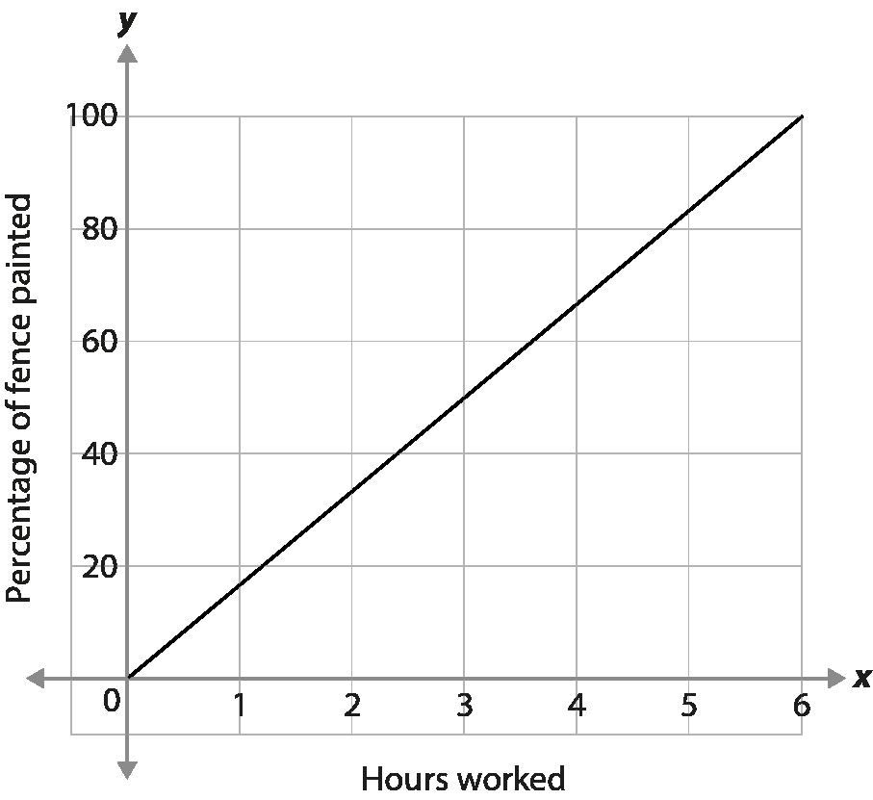
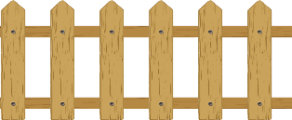
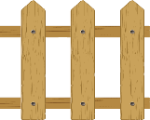
Checkpoint 16: Noah fence
Noah has six hours to paint a fence a darker colour. He uses the graph on the right to show how much he should have painted after each hour.
After two hours, the fence looks like this.
Do you think Noah is on schedule to finish painting the fence in six hours?
How should the fence look after four hours?
How accurately do you think the graph is likely to represent Noah’s progress?
Noah’s friend says he can paint 20% of the fence per hour. How would a graph of his rate on the same axes be different? How would it be the same?
Notes:
This slide is animated. Each question will appear separately so you can choose the pace at which to work with your class.
Answers
a) Noah isn’t quite on schedule. According to the graph, he should be over 30% of the way through. (He should be 33.3% of the way through, but it’s unlikely that students will be able to read this accurately from the graph.) The picture shows that he has painted six of the 20 fence panels and so is 30% of the way through.
b) After four hours he should have completed 66.7%. An answer between 60% and 70% is acceptable.
c) The graph shows progress that is directly proportional to the time spent. It is unlikely that this is anything more than a rough guide since Noah is likely to take breaks, and maybe slow down as he gets tired towards the end of the day.
? If sketched on the same axes, the line will reach 100% after five hours, and so will be a little shorter and a little steeper than the line shown on the slide.
Suggested questioning
What percentage of the fence does it look like Noah’s painted? Is it possible to be accurate?
How can you use the graph to work out how much painting Noah should have done at a particular time?
After how long should Noah have painted half the fence?
Things to think about
This task offers students a chance both to estimate and to calculate a precise answer. Decide which you want to encourage with your class – depending on the focus of your assessment – and how you might manage students who work in different ways.

Slide 50
Checkpoint 16: Guidance
Adaptations | Assessing understanding
Support Work with students to interpret the situation, scaffolding the process a little. Start by asking them how much of the fence the graph suggests Noah should have painted after two hours, then estimate whether this has been achieved. Depending on your assessment focus, you may choose to not count the fence panels to improve the accuracy of this estimate. Challenge Ask students to consider how the graph would be extended if there were more fences to paint. Start with three times as many. What would change on the graph? Representations Students could sketch the fence as a bar model to help them ‘see’ the percentages. A double number line could also be used; do students connect the two sides of the line with the two axes on the graph? | Assess whether students are able to use a graph to interpret a proportional situation, and start to identify whether a situation is not proportional. Students are perhaps unlikely to have used linear graphs as a representation for proportion and this task allows their understanding of reasoning with a graph to be made visible. Look for students who are able to connect the representation of the fence and the graphical representation, and work between them. Part b may give insight into whether they choose to use the graph to estimate how the fence should look after four hours, or they calculate, or they double the image from part a.
Additional resources Explore ‘representing multiplicative relationships using double number lines’ from Secondary Mastery Professional Development | NCETM Additional activity H also explores a graphical representation for direct proportion.

Slide 51
Checkpoint 17: Counters
I can see the fraction $\frac{3}{5}$
Stevie
I can see the ratio 2:3
Mick
Four students look at these counters. They each say the first thing they see.
Who do you agree with and why?
Christine
I can see the fraction $\frac{2}{3}$
John
I can see 40%
I can see 150%
Lindsey
Notes:
This slide is animated. Each of the students’ statements will appear separately so you can choose the pace at which to work with your class.
Answers
All are correct but require looking at a different ‘whole’.
$\frac{3}{5}$ of all of the counters are red.
The ratio of yellow to red counters is 2:3.
There are $\frac{2}{3}$ as many yellow counters as red counters.
40% of all the counters are yellow.
? There are 150% as many red counters as yellow counters
Suggested questioning
Who do you agree with? Is there anyone you don’t agree with? Why?
What is $\frac{3}{5}$ of what?
What’s in the ratio 2:3?
What is $\frac{2}{3}$ of what?
What is 40% of what?
Things to think about
Identifying the $\frac{2}{3}$ can be challenging for students. Think about how to connect the ratio 2:3 with both the fractions $\frac{3}{5}$ and $\frac{2}{5}$, and with the fraction $\frac{2}{3}$ (and $\frac{3}{2}$). It’s common for students only to see 2:3 as $\frac{2}{5}$ and $\frac{3}{5}$, rather than seeing the alternative relationship that one part of the ratio is two-thirds of the other. Consider your language and explanations in supporting students to see this distinction.

Slide 52
Checkpoint 17: Guidance
Adaptations | Assessing understanding
Support Students are likely to be particularly challenged by Christine’s statement. Point out that the yellow is $\frac{2}{3}$ of the red, and discuss the validity of this comparison rather than withholding the ‘whole’. It is important to understand what students are seeing as $\frac{2}{3}$ or 2:3. Challenge Challenge students to identify other fractions, ratios and percentages that can be seen in the five counters. Increase the number of counters to six and see whether students begin to simplify the fractions and ratios. Representations A bar model might be helpful for this multiplicative comparison. Line up some counters to create a makeshift bar model to make the relationship between the model and the situation in the task more explicit. | When working with percentages it is often important to identify the ‘whole’, and to understand that this may change as the context of the question changes. For example, the common misconception of reversing a 10% increase by decreasing the result by 10% can be thought of as identifying the wrong value as 100%. See how readily students are able to shift their perspective of what makes the ‘whole’ in each context. Stevie and Mick are seeing the group of five counters as the whole, while Christine is seeing the red counters as the whole and describing the number of yellow ones in relation to this. John is also describing the yellow counters but using the group of five counters as the whole. Assess whether students are equally comfortable with fractions, percentages and ratios to describe the relationship between a part and a whole. It should also help you to assess how readily students can think about ratios as a part–whole relationship, when they might be more familiar with part–part.
Additional resources There is further exploration of multiplicative relationships in the Checkpoints deck ‘Understanding multiplicative relationships – fractions and ratio’.

Slide 53
Checkpoint 18: Fallen arrows
Oh no – the arrows of this function machine have fallen down the screen! They were all arranged carefully so that, when 10 was fed into the first one, the outcome of the last was 25.
Can you find the right order for the arrows?
10
$$÷3$$
$$×10$$
25
$$÷4$$
$$÷2$$
$$×2$$
$$×3$$
$$÷5$$
$$×5$$
Could you create one red (multiplication) arrow that could be used to replace all of the arrows? Could you create one blue (division) arrow that could replace them all?
Notes:
This slide is animated. The further thinking question will appear separately so you can choose the pace at which to work with your class.
Answers
Any order will work. The focus of this checkpoint is to explore whether students understand why this is the case
? $×$2.5 or $÷$ 0.4 (or equivalent) could replace all of the arrows
Suggested questioning
Do any of the arrows ‘cancel’ each other? Are there any that are the inverse of another?
What happens when we multiply and then divide by the same number?
What would happen if the order of these two was swapped?
Does the order of the arrows matter at all? Can you explain why?
How about if there were an arrow with +1 on it. Would anything change?
Things to think about
All students should find that their arrangement of arrows works. Think about how to manage and sequence the discussion after this becomes apparent. It is in this discussion that students’ understanding is made visible and your assessment of their understanding can be made. Consider how important you feel the use of correct terminology is at this stage. Some students may understand commutativity, but not know the word; others may have learnt a phrase without understanding its application. Managing classroom discussion effectively here will be key to both your assessment and to students clarifying and learning from each others’ ideas.

Slide 54
Checkpoint 18: Guidance
Adaptations | Assessing understanding
Support Encourage students to break the task down, one arrow at a time. Use prompts such as, ‘Which is an easy arrow to work out next?’ or, ‘What happens when we multiply and then divide by the same number?’ to get students started. Challenge Challenge students to write a similar set of arrows using only multiplication and division to move from 10 to 25, or between two numbers of their choice. Is it always possible to move between any two numbers using just multiplication and division? Representations Think carefully about how the language you use can represent the structure of the calculations differently – you could use a bar model to reflect the language used. For example, using a quotitive (grouping) model for division: describe 10 × 3 as “ten threes (which equals 30)”, and then 30 ÷ 3 as “how many threes in 30?” This would be represented by a bar model split into ten parts. Using a partitive (sharing) mode: describe 10 × 3 as “ten, three times the size” followed by 30 ÷ 3 as “30, one-third the size”. This would be represented by a bar model split into three parts. The guidance Teaching mathematics in primary schools avoids referring to × 3 as ‘making three times bigger’, or ÷ 3 as ‘making three times smaller’. | Checkpoint 18 assesses whether students understand that, with multiplication and division, the order that they are carried out doesn’t matter and that multiple calculations can be replaced by one single operation. The intention is to check readiness for moving to a single multiplier for finding a percentage at Key Stage 3. All students will ‘luckily’ land on the right solution first time, so this does not necessarily indicate understanding. Students’ level of surprise at reaching the right answer might be more indicative of whether they have understood the mathematical structures that sit underneath this task! Explore whether they can understand why this has happened. Is it luck, or do they understand that it’s a property of the operations?
Additional resources Additional activities I and J link the representation of the function machine more explicitly to percentages and equivalent calculations to find percentages.

Slide 55
Checkpoint 19: Empty boxes
Using a single digit in each box, how many different ways can you find to complete these statements correctly?
You may use the same digit more than once.
a)
3
b)
6
is
is
of
of
is
of
Notes:
This slide is animated. Each question will appear separately so you can choose the pace at which to work with your class.
Answers
a) Placing 3 in the yellow circle would mean that, as long as the numerator and green rectangle have the same digit, the expression will be correct (for example, 3 is $\frac{3}{4}$ of 4, 3 is $\frac{3}{7}$ of 7 etc). Other possible correct solutions are 1 is $\frac{3}{6}$ of 2, 2 is $\frac{3}{6}$of 4, 4 is $\frac{3}{6}$ of 8, 1 is $\frac{3}{9}$ of 3, 2 is $\frac{3}{9}$ of 6. A correct set of solutions can also be made by placing 3 in the blue rectangle, so creating, for example, 5 is $\frac{3}{3}$ of 5 and 8 is $\frac{3}{3}$ of 8.
b) Placing a 6 in the numerator box would mean that, as long as the denominator and green rectangle have the same digit, the expression will be correct (for example, 6 is $\frac{6}{7}$ of 7 and 6 is $\frac{6}{8}$ of 8 etc). Other possible correct solutions are 6 is $\frac{2}{3}$ of 9 and 6 is $\frac{3}{4}$ of 8. A correct set of solutions can also be made using a fraction equivalent to 1 by placing the same digit in the blue and red rectangles, so creating 6 is $\frac{3}{3}$ of 6 and 6 is $\frac{9}{9}$ of 6.
? Students’ responses will vary. You can use the principles described in the answers to parts a and b above to help sense check most possible answers (i.e. if the values of the numerator and yellow circle are the same, and the values of the denominator and the green rectangle are the same, then the statement must be true). Try simplifying students’ fractions before checking if this rule applies.
Suggested questioning
Are there any simple ones to get started with?
Do you know any equivalent fractions that could be useful?
How do you know you’ve got all possible answers?
Things to think about
Students may be keen to ‘complete’ the task by finding all of the possible solutions. Think about how to move students on once the key assessment point has been addressed. What is the focus of the task?

Slide 56
Checkpoint 19: Guidance
Adaptations | Assessing understanding
Support Reduce the number of possibilities to help students start the task. For part a, telling students that the denominator box contains a 5 reduces the number of correct answers significantly while still allowing students to demonstrate their understanding. Challenge Challenge students to consider the validity of improper fractions, and to argue their case. Is it valid to say that 3 is $\frac{3}{1}$of 1 for example? By pushing the boundaries of the notation, students may expose more of their understanding. Representations Familiar pictorial representations for fractions, such as bar models, may help students to test their statements. A number line may also be useful to help students sense-check the relationship between each part of their statement. | This task explores how fluent students are at finding fractions of amounts, and whether they are able to describe one number as a fraction of another. Look for students who are able to identify that, in part a, placing a 3 in the yellow circle means that any digit can be repeated in the denominator and green rectangle (for example, 3 is $\frac{3}{6}$of 6, 3 is $\frac{3}{7}$of 7 or 3 is $\frac{3}{8}$ of 8). Discuss whether the statement 3 is $\frac{3}{2}$of 2 to reveal the depth of students’ understanding. Part b looks for equivalent fractions. Students who write 6 is $\frac{6}{8}$of 8 and follow this with 6 is $\frac{3}{4}$of 8 are likely to have a good understanding of what it means for fractions to be equivalent. Conversations around the validity of improper fractions will expose students’ understanding.
Additional resources For further assessment of fractions as an example of a multiplicative relationship, see the Checkpoints deck ‘Understanding multiplicative relationships – fractions and ratio’.

Slide 57
Checkpoint 20: On target
Robyn is practising archery using the target on the right. The gaps between each circle are always the same.
She hits the target five times. Arrow a lands 10 cm from the centre of the target.
How far are arrows b to e from the centre of the target?
d
e
a
10
9
8
7
6
5
4
3
2
1
c
b
Robyn fires two more arrows. One is three times further from the centre than the other. Where could both arrows be?
Notes:
This slide is animated. Each ‘arrow’, and then the further thinking question, will appear separately so you can choose the pace at which to work with your class.
Answers
a) 10 cm, so each ring is 2.5 cm apart.
b) 17.5 cm
c) 15 cm
d) 22.5 cm
e) 7.5 cm
? The arrow closest to the centre must be in the first part of the red section (marked 8). As a maximum, it can be one-third of the way into the second red ring (marked 7).
Suggested questioning
How might the circles help to work out the distances?
How could you work out how far apart the circles are?
Can you use any of the other arrows to help with this answer?
Things to think about
It is assumed in the context of this task that all the arrows land on the lines, which you might like to clarify. Multiple methods are likely to be used by students. Think about which student methods you’ll share, and which order you and the class will explore them in.

Slide 58
Checkpoint 20: Guidance
Adaptations | Assessing understanding
Support Encourage students to begin to think multiplicatively by asking about distances which are twice as far as the first arrow (the outside edge of the black section) or half as far (the outside edge of the yellow). Challenge Encourage students to make other multiplicative comparisons. For example, arrow c is two times further from the centre than arrow e. Is it possible to make statements like this for other arrows? Representations A double number line may help. Use the centre of the target as 0 on the number line. Drew this and position at different angles on the circle to model the connection between the two representations. | See whether students are able to use the unitary method to solve problems, perhaps informally. Look for students who are first able to identify that the rings are 2.5 cm apart, and who use this to calculate the other distances. There are, of course, other ways to work with this task (such as noticing that arrow c is ‘half as far again’ as arrow a) but it is likely that a unitary method will be the most common. If other methods be used, ask students to share and discuss their thoughts. Comparing methods, and seeing whether students are able to identify why they are the same, is useful for assessing students’ multiplicative reasoning. Key to the unitary method is an understanding of ‘per’ or ‘for every one’. When discussing different strategies, this is a common reference to use.
Additional resources There are other examples of using scaling in Primary Mastery Professional Development | NCETM: segment 2.17 Structures: using measures and comparison to understand scaling and segment 2.27 Scale factors, ratio and proportional reasoning

Slide 59
Additional activities
Activities A–J

Slide 60
Activity A: Blank grids
Shade part of the hundred grid on the right
Complete the sentence: __% of the grid is shaded.
Then shade the same percentage of shapes A to I.
G
A
B
C
F
D
H
E
I
Draw some more grids with different numbers of squares. Can you shade your percentage on each of these grids?
Notes:
This slide is animated. Each of shapes A to I will appear separately so you can choose the pace at which to work with your class. To shade the grids, students will need the printable version on slide 76.
Answers
The answers to this task will vary for each student.
Suggested questioning
Can you shade a percentage that no one else in the class has shaded?
How can you accurately shade that percentage on the grid? What will you look for?
Are there any calculations you could do that might help you to be accurate?
Things to think about
Think about how to collect and check responses from students. Which grids were the most challenging, and which instigated the most errors from your class. The further thinking question asks students to create their own grids – do they realise that choosing grids with a number of squares that is a factor of 100 is easier? If they do, challenge them to use different grids with a number of squares that isn’t a factor of 100 but is close to one. How accurately are they able to estimate a percentage of, say, a 21 square grid or six square grid?

Slide 61
Activity B: Fewer grids
What percentage is shaded on the 100 grid on the right?
Shade the same percentage on grids A to F.
A
E
B
C
F
D
Draw some more grids with different numbers of sections. Can you shade your percentage on each of these grids?
Notes:
This slide is animated. Each question and grid will appear separately so you can choose the pace at which to work with your class. To shade the grids, students will need the printable version on slide 77.
Answers
See the following slide for some suggestions of what the shading might look like. The actual sections that students shade may vary, but they need to be the equivalent of:
A: 15 sections
B: 3 sections
C: 6 sections
D: 15 sections
E: 0.6 sections
F: 1.5 sections
? Students’ responses will vary.
Suggested questioning
What’s the same and what’s different between these two grids?
Can you use any of your other answers to help you?
Does writing the percentage as a fraction or a decimal help?
Things to think about
What shapes do you offer students to work with when looking at fractions and percentages? Often the grids used contain a ‘friendly’ number of cells.
In this task, students may use previous grids to help with the next. For example, since the original 100 grid and shape E align, extending the shaded area from the hundred square to E will shade the required 30%. Similarly, shapes B and D have the same number of columns and so the same number need to be shaded in each. This method may not be intuitive to many students. Consider how to explore and develop this in advance of the lesson.
Think about collecting responses from students and how to check these. Consider how to gain feedback about which grids were the most challenging, and which instigated the most errors from your class.

Slide 62
Activity B: Fewer grids (some possible solutions)
What percentage is shaded on the 100 grid on the right?
Shade the same percentage on grids A to F.
30%
A
E
B
C
F
D
Notes:
This slide is animated. An example solution will appear separately for each grid so you can choose the pace at which to work with your class.

Slide 63
Activity C: Value of a square
If the whole hundred grid has a value of __, what is the value of:
1 square
2 squares
12 squares
50 squares
97 squares?
How could you write your answers for parts a to e as calculations?
If 12 squares are worth __, what would 1 square be worth? How about the whole grid?
Notes:
This slide is animated. Each question will appear separately so you can choose the pace at which to work with your class.
Answers
Answers will vary according to the value of the 100 square.
Suggested questioning
Are any of the questions easier to answer than others?
Which do you think you’ll be able to answer without a calculator?
What would happen if we double the value of the hundred square?
Things to think about
This task doesn’t explicitly mention percentages. Think about the language you use to describe the task and the strategies you use to hear the ways that students go about calculating the different values. Students who have a method for calculating percentages, but maybe no understanding of the underpinning structures, may not make the connection between this task and their method. Consider how you’ll support them to do this. Part f asks students to write their answers as calculations; this is a good opportunity to gain insight into how students organise their thinking and how accurately they can notate this. This should help you to with your own decisions about how explicitly you need to teach the setting out of calculations.

Slide 64
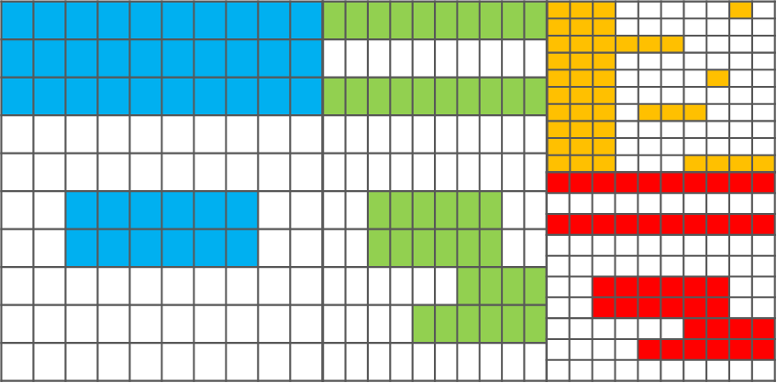
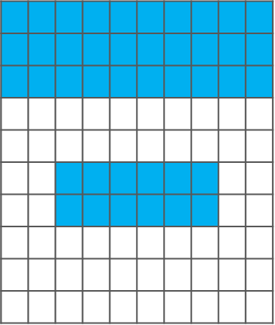
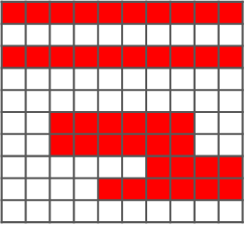
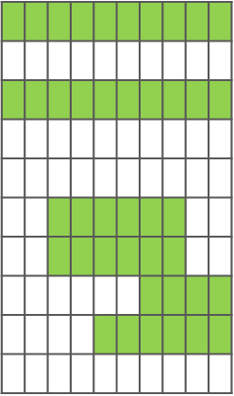
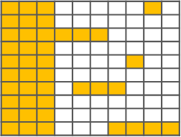
Activity D: 42%
Four students each shade the same percentage of their grids.
What percentage is shaded?
They stick the grids together.
What percentage of the whole grid is shaded?
What percentage of the total grid would be shaded if:
The students shaded one more rectangle on each smaller grid?
They then shaded four more rectangles on just the left-hand (blue) grid?
Notes:
This slide is animated. Each question will appear separately so you can choose the pace at which to work with your class.
Answers
a) 42%
b) 42% of the total grid is shaded.
? One more square has been shaded on each grid, so 43% is now shaded.
The rectangles on the left-hand (blue) grid are larger than the other rectangles. It’s not possible to say what percentage of the total is shaded, but it is possible to say that it must be greater than 44%.
Suggested questioning
For part a, which 42% was easier for you to see? Why?
Would it be 42% is we used only the red pattern?
How about if we added another 10 red grids to the pattern? Will it still be 42%?
Things to think about
The intention here is to learn about students’ understanding through their explanations and reasoning. Think ahead about how to manage it in the classroom. How will you ensure that students feel confident enough to give arguments and counter arguments, that might ultimately be disproved? Activities like this are most effective within a classroom environment where all students’ voices can be heard, and where all students feel comfortable with being wrong.

Slide 65
Activity E: Match up again
Match into pairs using equivalent fractions, decimals or percentages.
Write the missing fraction, decimal or percentage to make each pair a set of three.
$$\frac{1}{4}$$
0.3
$$\frac{1}{5}$$
0.2
30%
0.5
$$\frac{1}{2}$$
1.2
0.25
40%
120%
$$\frac{2}{5}$$
Create another equivalent fraction to turn each set of three into a set of four. Can you think of an equivalent fraction that nobody else will choose?
Notes:
This slide is animated. The blank cards and part b will appear separately so you can choose the pace at which to reveal the slide to your class. Printable cards are available on slides 79–96, with instructions for printing on slide 78.
Answers
a)
$\frac{1}{4}$ = 0.25
$\frac{1}{2}$ = 0.5
$\frac{1}{5}$ = 0.2
30% = 0.3
40% = $\frac{2}{5}$
120% = 1.2
b)
Throughout, equivalent fractions may be given, such as $\frac{3}{100}$ in place of $\frac{3}{10}$ .
20% = $\frac{1}{5}$ = 0.2
25% = $\frac{1}{4}$ = 0.25
30% = $\frac{3}{10}$ = 0.3
40% = $\frac{2}{5}$ = 0.4
50% = $\frac{1}{2}$ = 0.5
120% = $\frac{12}{10}$= 1.2
? Any equivalent fraction or decimal for each set. Students may be likely to select more ‘common’ or easy to derive equivalences such as $\frac{3}{6}$ for $\frac{1}{2}$, so the prompt them to think of a fraction that nobody else will choose to encourage them to be more creative, such as $\frac{303}{606}$ for $\frac{1}{2}$.
Suggested questioning
Which of these do you know and which do you have to work out?
How can you use other known facts to help you work out the answer?
If you know the value as a decimal, how can you convert it to a percentage?
Things to think about
Activity E assesses some common equivalences that students are likely to know from their work on decimals and fractions at primary school. It is a development of a similar Checkpoint from the ‘Arithmetic procedures including fractions’ deck.

Slide 66
Activity F: Relative ages
Padma is eight years old. Her brother Howard is four and her sister Parvati is 16.
Which of these statements are correct? Why?
Padma says, ‘My brother is 50% younger and my sister is 50% older than me.’
Howard says, ‘One sister is 100% older and the other is 400% older than me.’
Parvati says, ‘My brother is 25% younger and my sister is 50% younger than me.’
Maya says, ‘My sister is 25% younger than me and my brother is 20% older than me.’
What could their possible ages be?
How would Maya’s sentence change in 20 years’ time?
Notes:
This slide is animated. Each question and then the further thinking questions will appear separately so you can choose the pace at which to work with your class.
Answers
a) Padma is partially correct. Howard is 50% younger than her but Parvati is actually 100% older. Padma has got confused with the idea that her age is 50% of Parvati’s age.
b) Howard is partially correct. Padma is 100% older but Parvati is actually 300% older. Howard has got confused with the idea that Parvati’s age is 400% of his age. Note the use of the comparative ‘older’ here, which means that we are looking at the difference between their ages in relation to Howard’s age. You could also describe Padma as 200% of Howard’s age rather than being 100% older; this distinction has the potential to confuse.
c) Parvati is partially correct. Padma is 50% younger than her, but Howard is actually 75% younger than her. Parvati has got confused with the idea that Howard’s age is 25% of her age.
? There are multiple possible answers; infinite if students specify ages in fractions of years. The most likely integer answers are:
Maya: 20, Maya’s sister: 15, Maya’s brother: 24. In 20 years’ time Maya’s sister would be 12.5% younger and Maya’s brother would be 10% older).
Maya: 40, Maya’s sister: 30, Maya’s brother: 48 In 20 years’ time Maya’s sister would be 16.$\dot{6}$% younger and Maya’s brother would be 13.$\dot{3}$% older.
Suggested questioning
What is 100% in this situation?
What would 50% more/less than this be?
How might thinking in fractions help you?
How could you change the statements so that they are true?
Things to think about
Additional activity F plays with some common misconceptions around percentages, particularly around what value is 100% and how other values relate to it. Careful use of language – and checking that students understand how nuances in language can change the meaning of a statement – are key to this task. For example, Padma’s statement would be true if it read, ‘My brother is 50% of my age and I am 50% of my sister’s age.’ If students think that Padma’s statement on the slide is correct, probe further to find out whether this is because they misunderstand the mathematics, or because they are not sure of the language in the statement.

Slide 67
Activity G: Just three gaps
Use the values below to fill in the gaps.
How many different statements can you make? You can use each value more than once.
__ % of __ is __.
2
25
1 000
250
200
50
20
5
500
Which values could you not write in the last gap?
What numbers would you need to include so that you could write those values in the last gap?
Notes:
This slide is animated. Each question will appear separately so you can choose the pace at which to work with your class.
Answers
50% of 1000 is 500; 25% of 1000 is 250; 20% of 1000 is 200; 5% of 1000 is 50; 2% of 1000 is 5
50% of 500 is 250; 5% of 500 is 25
20% of 250 is 50; 2% of 250 is 5
250% of 200 is 500
50% of 50 is 25
20% of 25 is 5
250% of 20 is 50
500% of 5 is 25, 1000% of 5 is 50
1000% of 2 is 20
? You cannot write the numbers 2 or 20 in the last gap unless you introduce another number card (for example 10, so that 20% of 10 is 2 or 10% of 200 is 20).
Students might suggest that you cannot write 1 000, but 500% of 200 is 1000.
Suggested questioning
What’s a good starting point to solve the problem?
Are there any cards that must go together? Any that can’t go together? How do you know?
Things to think about
Thinking about how students might respond to a task is essential before using it. Activity G could be used interchangeably with Checkpoint 11. Checkpoint 11 presents a similar mathematical premise as a ‘puzzle’, with nine boxes to fill – but, for some students, this might prove to be a distraction or even a barrier if they feel like they cannot get started. This, more open, version may feel less threatening – rather than working towards a defined end goal, students are asked to generate as many statements as they can. The mathematical purpose is the same; to check their understanding of percentages of a quantity and how fluently they can connect one number as a percentage of another. See the Guidance slide for Checkpoint 11 for more information.

Slide 68
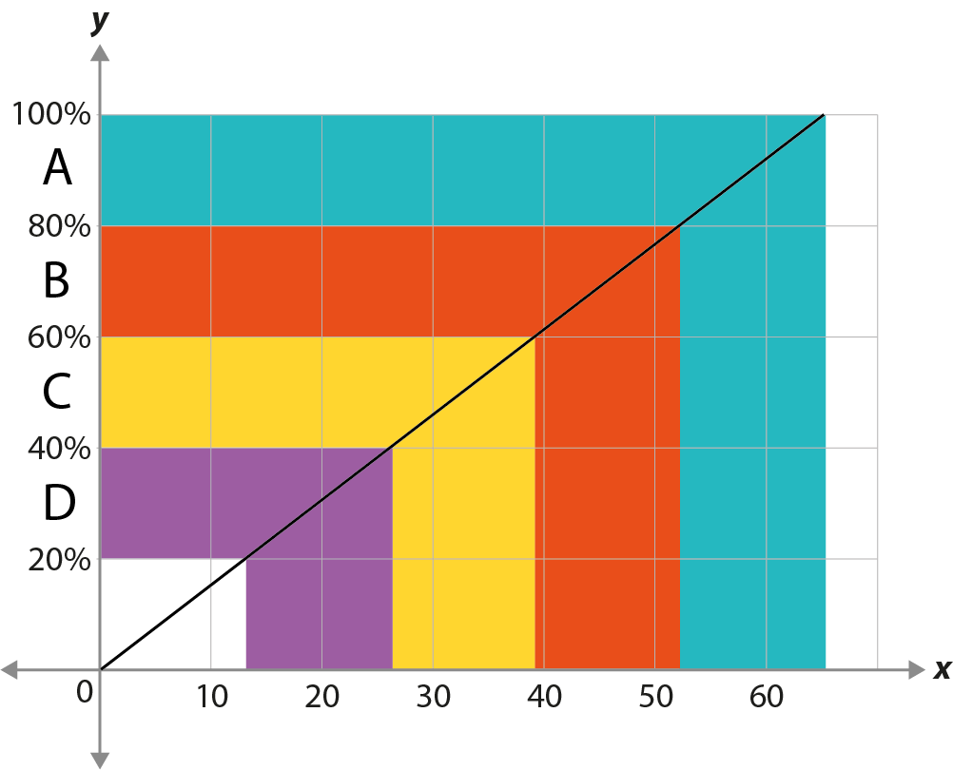
Activity H: Graph
A class of students took a test.
The grades available were A, B, C or D.
The graph helps the teacher convert a score out of 65 to a grade.
Hugo scored 35 marks on his assessment.
What grade did Hugo get?
Estimate his percentage score.
Estimate the minimum mark you need to get a grade. What calculation could you carry out to be more accurate?
Marks (out of 65)
A different test was scored out of 150 marks instead of 65. How will the graph for this test look different? How will it look the same?
Notes:
This slide is animated. Each question and then the further thinking question will appear separately so you can choose the pace at which to work with your class. The graph and description are visible before the questions; focus on this before revealing the questions, and ask students what they know or notice about the graph first.
Answers
a) 35 marks is a grade C.
b) Hugo scored 54% (an estimate between 50% and 60% is reasonable).
c) 13 is the minimum mark needed for a grade. The calculation is 65 $×$ 0.12 (or equivalent).
Suggested questioning
Are the coloured bars on the x axis all the same width? How wide are they?
Is there a calculation you could carry out to find the boundaries accurately?
Estimate the grade boundary for a grade __.
Things to think about
The context of grade boundaries is likely to be familiar to most students. Think about how to manage the discussion about assessments which are out of a different number of marks – the question ‘what’s the same and what’s different’ can be powerful, but thought needs to be given to the reason for asking, and which likely student responses will be explored further, while others are put on the back burner.

Slide 69
Activity I: Matching machines
Which of these function machines show the same calculation?
$$÷10$$
$$×4$$
$$÷5$$
$$×2$$
A
E
$$÷4$$
$$×10$$
$$÷10$$
$$×2$$
B
F
$$÷100$$
$$×40$$
$$÷100$$
$$×10$$
C
G
$$÷5$$
$$÷2$$
$$÷100$$
$$×20$$
D
H
Is there another function machine that would match any of these calculations? Is there one with a single red (multiplication) arrow? How about a single blue (division) arrow?
Notes:
This slide is animated. Each function machine, and then the further thinking question, will appear separately so you can choose the pace at which to work with your class. Students will need to see multiple function machines in order to complete the task – however, just showing the first three or four at first, and then one or two more at a time, would be sufficient to spot some matching calculations.
Answers
A, C and E all show the same calculation (equivalent to finding 40%).
F and H both show the same calculation (equivalent to finding 20%).
D and G both show the same calculation (equivalent to finding 10%).
B does not match to any other machine; its calculation is equivalent to finding 250%.
? There are infinite possible answers as long as both arrows on the function machine have been multiplied by the same number.
Single multipliers/divisors:
Finding 40% (A, C and E): × 0.4, ÷ 2.5 (or equivalent)
Finding 20% (F and H): × 0.2, ÷ 5 (or equivalent)
Finding 10% (D and G): × 0.1, ÷ 10 (or equivalent)
Finding 250% (B): × 2.5, ÷ 0.4 (or equivalent)
Suggested questioning
What connections are you looking for between the different machines?
What’s the same and what’s different about this set of machines?
Things to think about
Checkpoint 20, Activity I and Activity J all explore a similar theme – the idea of commutativity and equivalent calculations. Whilst the link to percentages is not made explicit in any of the main tasks (although we have made reference to percentages in the answers), an understanding of what multiplications and divisions are equivalent is essential for both fluency with percentage calculations and a deep and connected understanding of how percentages work. Decide whether you will refer to percentages in your answers or wait to see if students volunteer the connection. Even if they do not make the connection to percentages, you will gain valuable assessment insight into students’ understanding of place value and equivalence. Discuss the advantages and disadvantages of, for example, using ‘decomposition’ to show that A$÷$10 and $×$4 gives the same result as C$÷$100 and $×$40 because it can be rewritten as $÷$10, $×$4, $÷$10, $×$10. It is worth also considering the importance you place on correct terminology. Students may understand commutativity, but not know the word, while others may have learnt a phrase without understanding its application.

Slide 70
Activity J: Correct machines?
Fawwaz says that all these machines could be replaced by the single calculation $×$ 0.8.
Is he correct? Explain your reasoning.
$$÷10$$
$$×8$$
$$÷10$$
$$×80$$
$$÷10$$
A
D
$$÷8$$
$$×10$$
$$÷15$$
$$×12$$
B
E
$$÷5$$
$$×4$$
$$÷20$$
$$×2$$
$$×2$$
C
F
Where Fawwaz was not correct, what is the single calculation that could replace that machine? What other machines would have the same outcome?
Notes:
This slide is animated. Each function machine, and then the further thinking question, will appear separately so you can choose the pace at which to work with your class. It is up to you whether you would prefer students to complete the task considering just one or multiple function machines at a time.
Answers
A Yes
B No
C Yes
D Yes
E Yes
F No
? B $×$ 1.25; any equivalent calculation is valid.
F $×$ 0.4; any equivalent calculation is valid.
Suggested questioning
What is the same and what is different between each machine?
Things to think about
Checkpoint 20, Activity I and Activity J all explore a similar theme – the idea of commutativity and equivalent calculations. While the link to percentages is not made explicit in any of the main tasks (just in the answers), an understanding of what multiplications and divisions are equivalent is essential for both fluency with percentage calculations and a deep and connected understanding of how percentages work. Decide whether you will refer to percentages in your answers or wait to see if students volunteer the connection. Even if they do not make the connection to percentages, you will gain valuable assessment insight into students’ understanding of place value and equivalence. Discuss the advantages and disadvantages of, for example, using ‘decomposition’ to show that A$÷$10 and $×$4 gives the same result as C$÷$100 and $×$40 because it can be rewritten as $÷$10, $×$4, $÷$10, $×$10. It is worth also considering the importance you place on correct terminology. Students may understand commutativity, but not know the word, while others may have learnt a phrase without understanding its application.

Slide 71
Printable resources

Slide 72
Notes:
These hundred grids (six on a page) might be a helpful representation to use with many of the tasks in this deck.

Slide 73
25%
60%
70%
25%
20%
Notes:
This printable resource (split over slides 73 and 74) might be useful for Checkpoint 1.

Slide 74
5%
10%
150%
120%
Notes:
This printable resource (split over slides 73 and 74) might be useful for Checkpoint 1.

Slide 75
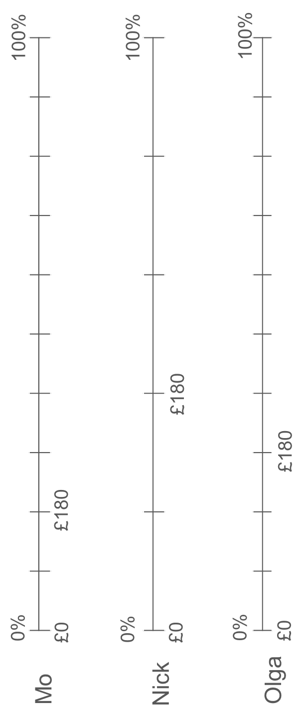
Notes:
This printable resource (three on a page) may be helpful for students working on Checkpoint 3.

Slide 76
__% of the grid is shaded.
Shade the same percentage of shapes A to I.
G
A
B
C
F
D
H
E
I
Notes:
This printable resource (one to a page) is for Checkpoint 6 and Additional Activity A. You will need to ask your students to shade the hundred grid first if you are using the example on Checkpoint 6.

Slide 77
__% of the grid is shaded.
Shade the same percentage of shapes A to F.
A
E
B
C
F
D
Notes:
This printable resource (one to a page) is for Additional activity B. You will need to ask your students to shade the hundred grid first if you are using the example on the slide.

Slide 78
Printable cards for Additional activity E
Print slides 79–96 to create sets of cards for students to work with. Stack and clip the set of 18 pages and cut along the lines to produce 20 sets.
Each set includes the 12 values shown within the activity, as well as 6 blank cards that students can use to turn each matching pair into a set of three.

Slide 79
$$\frac{1}{4}$$ | $$\frac{1}{4}$$ | $$\frac{1}{4}$$ | $$\frac{1}{4}$$ | $$\frac{1}{4}$$
$$\frac{1}{4}$$ | $$\frac{1}{4}$$ | $$\frac{1}{4}$$ | $$\frac{1}{4}$$ | $$\frac{1}{4}$$
$$\frac{1}{4}$$ | $$\frac{1}{4}$$ | $$\frac{1}{4}$$ | $$\frac{1}{4}$$ | $$\frac{1}{4}$$
$$\frac{1}{4}$$ | $$\frac{1}{4}$$ | $$\frac{1}{4}$$ | $$\frac{1}{4}$$ | $$\frac{1}{4}$$
Notes:
Printable card sort for Additional activity E: card 1

Slide 80
$$\frac{1}{2}$$ | $$\frac{1}{2}$$ | $$\frac{1}{2}$$ | $$\frac{1}{2}$$ | $$\frac{1}{2}$$
$$\frac{1}{2}$$ | $$\frac{1}{2}$$ | $$\frac{1}{2}$$ | $$\frac{1}{2}$$ | $$\frac{1}{2}$$
$$\frac{1}{2}$$ | $$\frac{1}{2}$$ | $$\frac{1}{2}$$ | $$\frac{1}{2}$$ | $$\frac{1}{2}$$
$$\frac{1}{2}$$ | $$\frac{1}{2}$$ | $$\frac{1}{2}$$ | $$\frac{1}{2}$$ | $$\frac{1}{2}$$
Notes:
Printable card sort for Additional activity E: card 2

Slide 81
$$\frac{1}{5}$$ | $$\frac{1}{5}$$ | $$\frac{1}{5}$$ | $$\frac{1}{5}$$ | $$\frac{1}{5}$$
$$\frac{1}{5}$$ | $$\frac{1}{5}$$ | $$\frac{1}{5}$$ | $$\frac{1}{5}$$ | $$\frac{1}{5}$$
$$\frac{1}{5}$$ | $$\frac{1}{5}$$ | $$\frac{1}{5}$$ | $$\frac{1}{5}$$ | $$\frac{1}{5}$$
$$\frac{1}{5}$$ | $$\frac{1}{5}$$ | $$\frac{1}{5}$$ | $$\frac{1}{5}$$ | $$\frac{1}{5}$$
Notes:
Printable card sort for Additional activity E: card 3

Slide 82
$$\frac{2}{5}$$ | $$\frac{2}{5}$$ | $$\frac{2}{5}$$ | $$\frac{2}{5}$$ | $$\frac{2}{5}$$
$$\frac{2}{5}$$ | $$\frac{2}{5}$$ | $$\frac{2}{5}$$ | $$\frac{2}{5}$$ | $$\frac{2}{5}$$
$$\frac{2}{5}$$ | $$\frac{2}{5}$$ | $$\frac{2}{5}$$ | $$\frac{2}{5}$$ | $$\frac{2}{5}$$
$$\frac{2}{5}$$ | $$\frac{2}{5}$$ | $$\frac{2}{5}$$ | $$\frac{2}{5}$$ | $$\frac{2}{5}$$
Notes:
Printable card sort for Additional activity E: card 4

Slide 83
0.2 | 0.2 | 0.2 | 0.2 | 0.2
0.2 | 0.2 | 0.2 | 0.2 | 0.2
0.2 | 0.2 | 0.2 | 0.2 | 0.2
0.2 | 0.2 | 0.2 | 0.2 | 0.2
Notes:
Printable card sort for Additional activity E: card 5

Slide 84
0.25 | 0.25 | 0.25 | 0.25 | 0.25
0.25 | 0.25 | 0.25 | 0.25 | 0.25
0.25 | 0.25 | 0.25 | 0.25 | 0.25
0.25 | 0.25 | 0.25 | 0.25 | 0.25
Notes:
Printable card sort for Additional activity E: card 6

Slide 85
0.3 | 0.3 | 0.3 | 0.3 | 0.3
0.3 | 0.3 | 0.3 | 0.3 | 0.3
0.3 | 0.3 | 0.3 | 0.3 | 0.3
0.3 | 0.3 | 0.3 | 0.3 | 0.3
Notes:
Printable card sort for Additional activity E: card 7

Slide 86
0.5 | 0.5 | 0.5 | 0.5 | 0.5
0.5 | 0.5 | 0.5 | 0.5 | 0.5
0.5 | 0.5 | 0.5 | 0.5 | 0.5
0.5 | 0.5 | 0.5 | 0.5 | 0.5
Notes:
Printable card sort for Additional activity E: card 8

Slide 87
1.2 | 1.2 | 1.2 | 1.2 | 1.2
1.2 | 1.2 | 1.2 | 1.2 | 1.2
1.2 | 1.2 | 1.2 | 1.2 | 1.2
1.2 | 1.2 | 1.2 | 1.2 | 1.2
Notes:
Printable card sort for Additional activity E: card 9

Slide 88
40% | 40% | 40% | 40% | 40%
40% | 40% | 40% | 40% | 40%
40% | 40% | 40% | 40% | 40%
40% | 40% | 40% | 40% | 40%
Notes:
Printable card sort for Additional activity E: card 10

Slide 89
30% | 30% | 30% | 30% | 30%
30% | 30% | 30% | 30% | 30%
30% | 30% | 30% | 30% | 30%
30% | 30% | 30% | 30% | 30%
Notes:
Printable card sort for Additional activity E: card 11

Slide 90
120% | 120% | 120% | 120% | 120%
120% | 120% | 120% | 120% | 120%
120% | 120% | 120% | 120% | 120%
120% | 120% | 120% | 120% | 120%
Notes:
Printable card sort for Additional activity E: card 12

Slide 91
Notes:
Printable card sort for Additional activity E: card 13

Slide 92
Notes:
Printable card sort for Additional activity E: card 14

Slide 93
Notes:
Printable card sort for Additional activity E: card 15

Slide 94
Notes:
Printable card sort for Additional activity E: card 16

Slide 95
Notes:
Printable card sort for Additional activity E: card 17

Slide 96
Notes:
Printable card sort for Additional activity E: card 18

