Slide 1
Teaching Primary Mathematics for Mastery
Debbie Morgan
Director of Primary Mathematics
NCETM
December 2015

Slide 2
Teaching Primary Mathematics for Mastery
Introduction

Slide 3
Learning from
The Chinese Paradox
Large Classes
Passive Learners
Rote Drilling
Large Classes
Active Learners
(mathematical thinkers)
Intelligent Practice
(leading to fluency)
x
The paradox does not exist because good quality
teaching actually takes place in Chinese mathematics
Classrooms (Huang 2004)

Slide 4
What does it mean to master something?
I know how to do it
It becomes automatic and I don’t need to think about it- for example driving a car
I’m really good at doing it – painting a room, or a picture
I can show someone else how to do it.

Slide 5
Mastery of Mathematics is more…..
Achievable for all
Deep and sustainable learning
The ability to build on something that has already been sufficiently mastered
The ability to reason about a concept and make connections
Conceptual and procedural fluency

Slide 6
Teaching for Mastery
The belief that all pupils can achieve
Keeping the class working together so that all can access and master mathematics
Development of deep mathematical understanding
Development of both factual/procedural and conceptual fluency
Longer time on key topics, providing time to go deeper and embed learning

Slide 7

What is Depth?

Slide 8
Partitioning and Combining

Slide 9
Partitioning and Combining

Slide 10

Part whole relationships
7 is the whole
3 is a part and 4 is a part

Slide 11
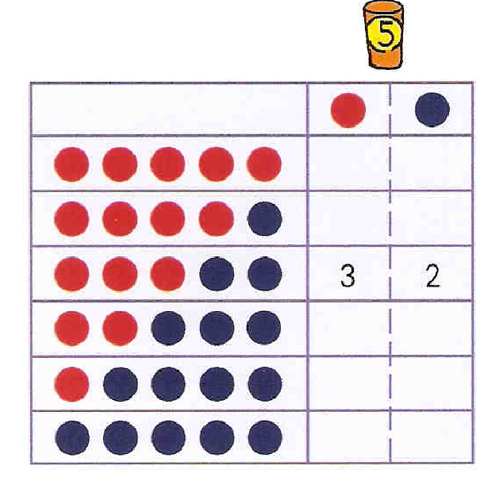
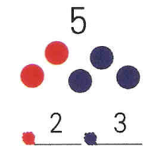
Representing the Part - Part Whole Model
Attention to Structure
Shanghai Textbook Grade 1 Semester 1

Slide 12
10
10
10
5
1
2
8
3
9
3
2
5
3
2
4
10
8

Slide 13
10
10
10
10
5
5
1
9
2
8
7
3
9
9
8
3
2
5
3
2
0
7
4
10
8
4

Slide 14
Teaching Primary Mathematics for Mastery
Depth shown in children’s work

Slide 15
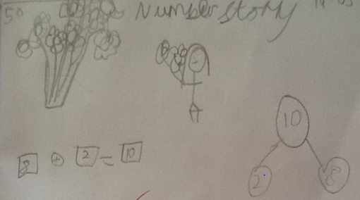
8 flowers and 2 flowers

Slide 16
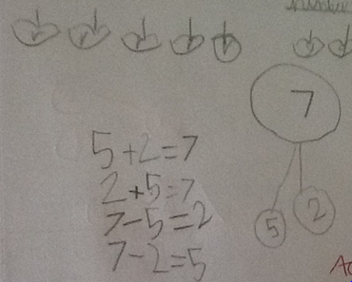
5 apples and 2 apples

Slide 17
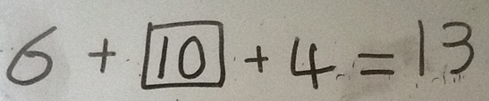
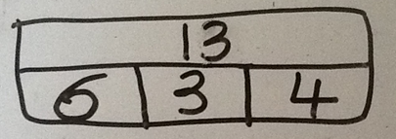
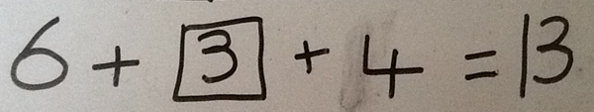
Amy

Slide 18
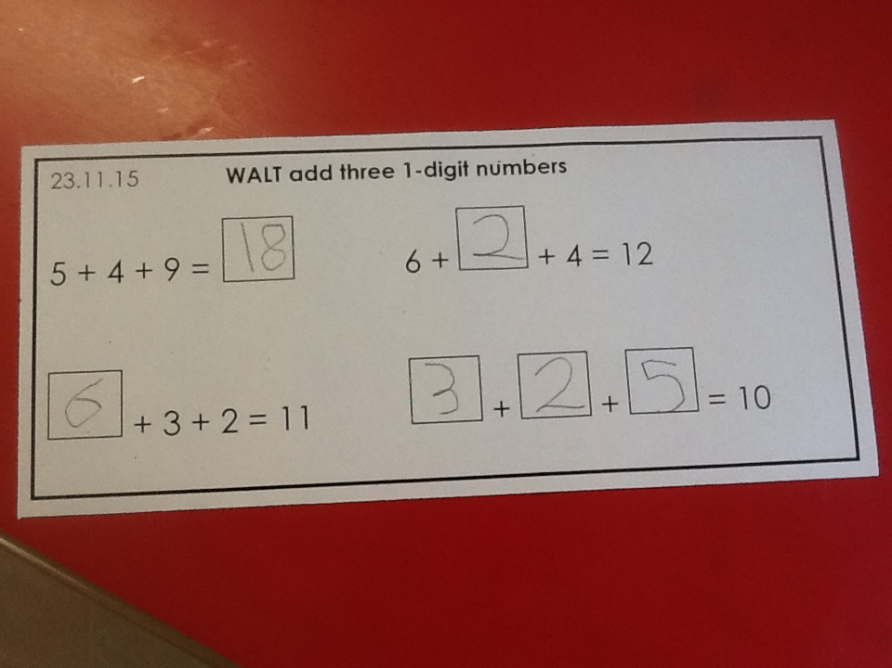

Slide 19
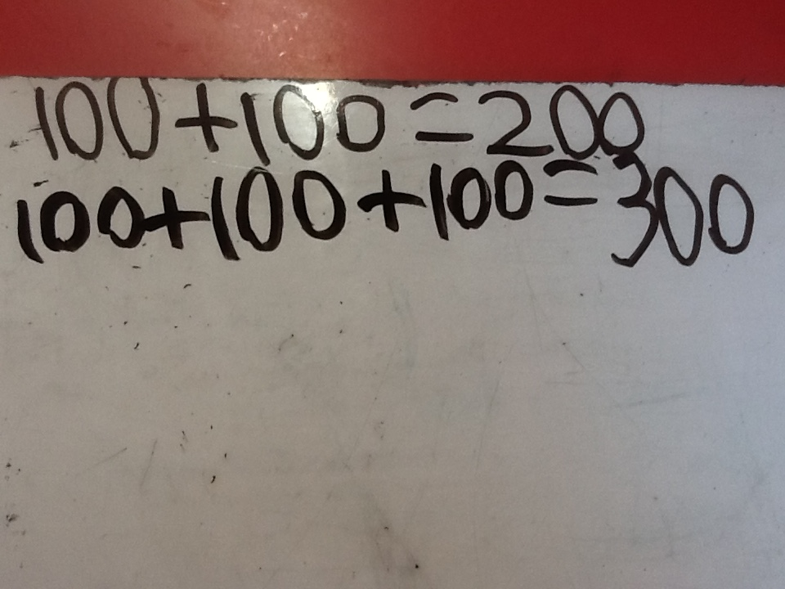

Slide 20
Teaching Primary Mathematics for Mastery
Using the bar model

Slide 21
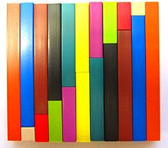
Developing Depth/Simplicity/Clarity
7
2
5
7
1.9
5.1
7.4
C
1.7
5.7
a
b

Slide 22
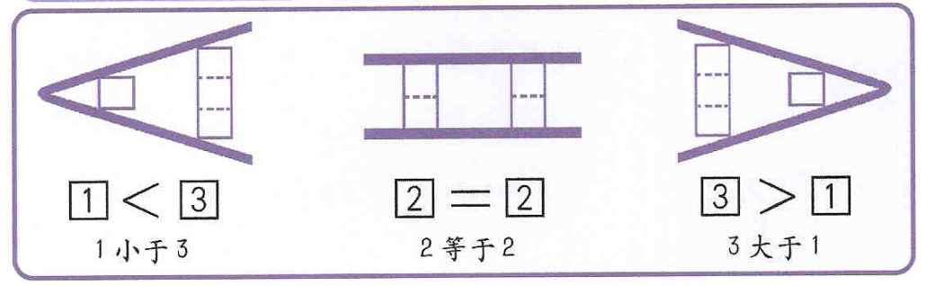
Equal and not equal
Attention to structure
And not a hungry crocodile in sight!

Slide 23

Ralph posts 40 letters, some of which are first class, and some are second.
He posts four times as many second class letters as first.
How many of each class of letter does he post?

Slide 24
40 letters
He posts four times as many second class letters as first.
How many of each class of letter does he post?
1st
40
2nd
Class
40 ÷ 5 = 8
8 x 4 = 32
1st Class 8 letters
2nd Class 32 letters
8
8
8
8
8

Slide 25
GCSE higher paper 2012!
Ralph posts 40 letters, some of which are first class, and some are second.
He posts four times as many second class letters as first.
How many of each class of letter does he post?

Slide 26
Teaching Primary Mathematics for Mastery
Meeting the needs of all learners
The implication for differentiation

Slide 27

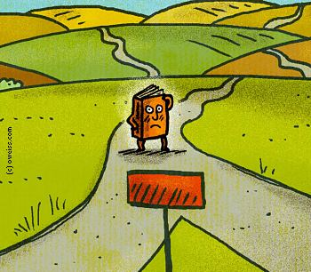
Meeting the needs of all pupils - The road to differentiation
Inclusion is important, but maybe we need to think about it in a different way

Slide 28
Teaching Primary Mathematics for Mastery
Examples from Chinese teachers’ slides and
Chinese textbooks

Slide 29
Teaching Primary Mathematics for Mastery
Examples from Chinese teachers’ slides and
Chinese textbooks

Slide 30
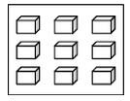
Review2：
How to illustrate these fractions on the diagram.

Slide 31
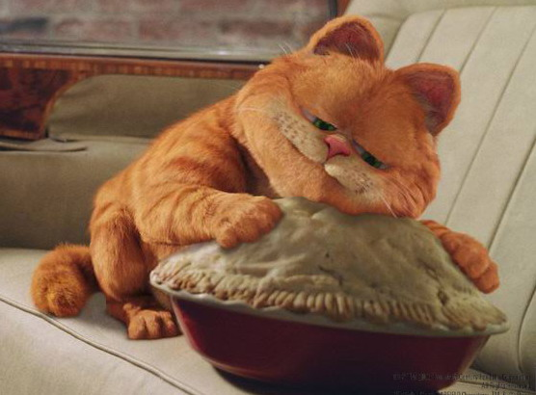
Thinking1:
Garfield likes to eat cake. Today, he ate of the cake. Not satisfied he ate of the cake later. How much cake did Garfield eat in total?
+
=

Slide 32
Formulation:
+
=
=
+

Slide 33
Rules of fraction addition
+
=
=
Keep the denominator the same and add the numerators.
Chinese teachers do not see repetition and understanding as separate but rather as interlocking processes, complementary to each other (Waktins & Biggs, 2001).

Slide 34
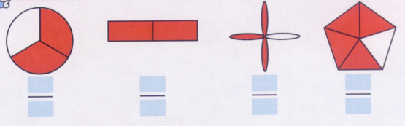
Providing Challenge
Shanghai Textbook Grade 3

Slide 35
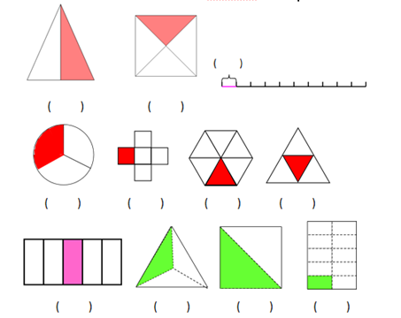
Use fractions to express the coloured parts

Slide 36
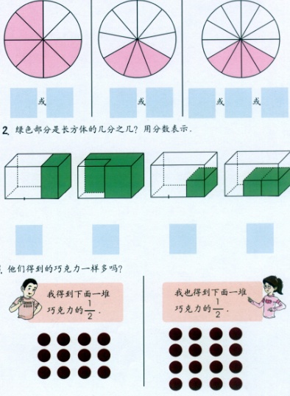
Conceptual Variation

Slide 37
True or False?
3
8
+
2
8
=
5
16
3
9
-
2
9
=
1
9
2
14
-
1
7
=
1
7

Slide 38
Looking at all aspects of the concept
Tasks which challenge and provoke reasoning
2 paper tapes were broken, can you guess which original paper tape is longer?
Why? How do you get your answer?
1
5
1
5
Variation to develop depth

Slide 39
Think: Which line is longer?
First
Second：

Slide 40
Teaching Primary Mathematics for Mastery
Variation

Slide 41
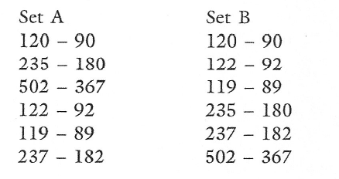
Variation Theory in Practice
Compare the two sets of calculations
What’s the same, what’s different?
Consider how variation can both narrow and broaden the focus
Taken from Mike Askew, Transforming Primary Mathematics, Chapter 6

Slide 42

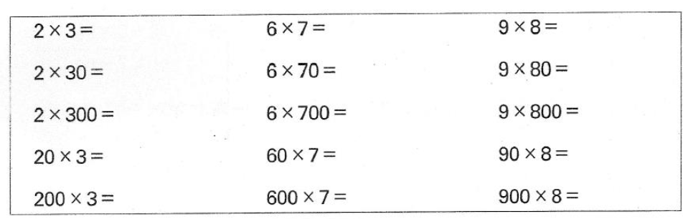
Variation leads to
Intelligent Practice
Shanghai Practice Book

Slide 43
Intelligent Practice
In designing [these] exercises, the teacher is advised to avoid mechanical repetition and to create an appropriate path for practising the thinking process with increasing creativity.
Gu, 1991

Slide 44
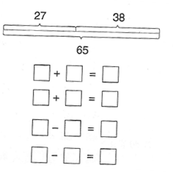
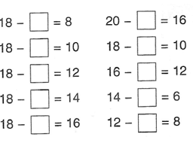
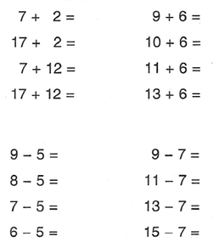
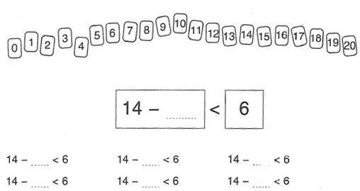
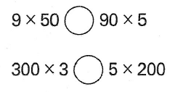
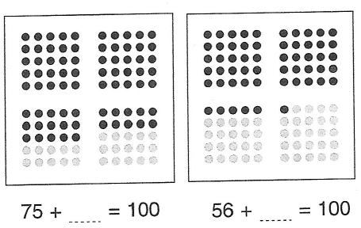
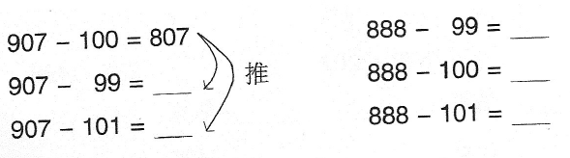
Intelligent Practice Noticing things that stay the same, things that change, providing the opportunities to reason make connections

Slide 45
Variation offers a systematic way to look
at mathematical exercises in terms of what
is available for the learner to notice.
(Marton, Runesson & Tsui, 2003)

Slide 46

Let’s teach for:
Deep
And sustainable learning
for all pupils

Slide 47
Lai
Lai (2009) Teaching with Procedural Variation: A
Chinese Way of Promoting Deep Understanding of
Mathematics

