Slide 1
Series 3 Episode 18
The Legend of Big Tum

Slide 2
Practitioner Notes

Slide 3
Episode Description
The Numberblocks walk to the top of Blocky Mountain where they are met by Big Tum, a hairy monster who loves missing-number puzzles. When some of the Numberblocks go missing, Big Tum challenges those still there to solve some puzzles to find out which of their friends are in Big Tum’s hairy tummy.

Slide 4
Maths in the Episode
Solving Missing Number Problems
Each problem involves identifying a missing number, represented by Big Tum with an empty box on his tummy to represent an unknown amount. Each problem is also represented using numbers and symbols. Solving the puzzle involves identifying what is known and using that information to find what is unknown.
In the first problem when the Numberblocks line up they realise that someone is missing. By organising themselves in increasing value they realise that Four is missing. 1,2,3,o,5…
In the second puzzle, Big Tum is hiding part of Nine. Only Three is visible. The arithmetic problem to solve is: 9 - o = 3.
In the third puzzle, Big Tum is hiding four Numberblock friends who have come together to make one Numberblock. Five has to work out who is in Big Tum’s tummy using the arithmetic 1 + 2 + 3 + 4 = o.

Slide 5
Using Mathematical Language
Use these stem sentences to rehearse the mathematical ideas in the programme:
If <Nine> was with Big Tum>
and <Three is left>
Then <Six is the missing Numberblock>
If we have <9>
and <3> is left
Then <6> is the unknown
Notes:
Text inside < > indicates what can be changed.
Encourage children to explain their reasoning. For example: Six must be the missing number because 6 and 3 make 9, OR 6 must be the missing number because 9 take away 3 is 6.

Slide 6
Talk and Discuss Together

Slide 7
Talk and Discuss Together
Watch the episode of Numberblocks. First ask the children what they noticed and allow them to talk to you and each other. Has anyone ever heard of the Yeti or Bigfoot?
What do you think is Big Tum’s favourite thing to do?
The following slides are designed to stimulate children and adults to talk about the episode and draw out some key aspects of the mathematics.

Slide 8
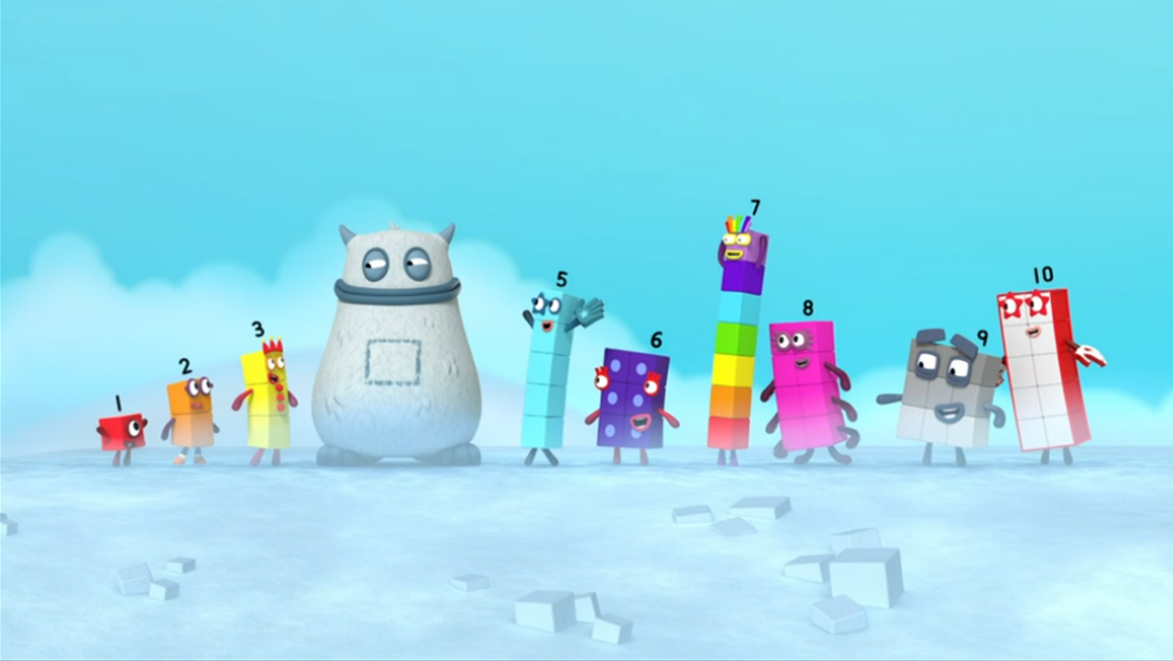
Images © 2017 Alphablocks Ltd. All Rights Reserved.
Notes:
Use this slide for talking and discussing together.

Slide 9
Enabling Environments in Reception

Slide 10
Enabling Environments
Playing and Exploring
Leave out images of the Numberblocks with one missing. Peg them out on a washing line to find out who Big Tum is hiding today.
Active Learning
Notice whether the children organise quantities in order to find out which is more or less. Listen out for children saying numbers in order and whether any number name is missing.
Creating and Thinking Critically
In a small group, provide a feely bag containing interlocking cubes which represent each Numberblock. Everyone shuts their eyes while one person removes a Numberblock tower from the feely bag and hides it from the rest. Open eyes and take out one tower at a time from the feely bag, laying them out on table. Who might be left in the bag? How can we work out who is missing?

Slide 11
Learning Together in Y1

Slide 12
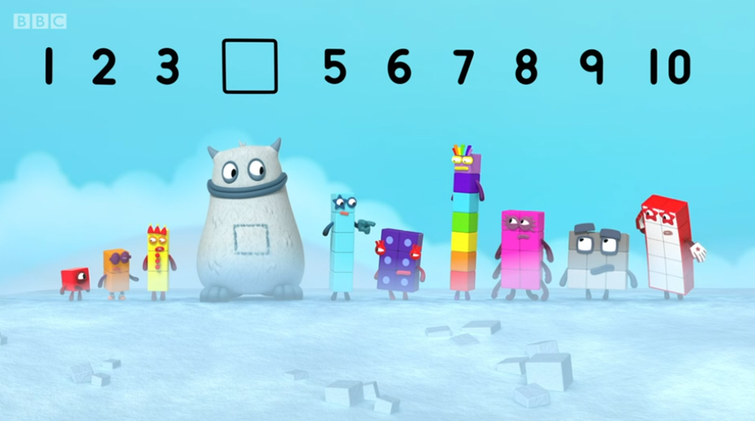
is more than .
is less than .
Images © 2017 Alphablocks Ltd. All Rights Reserved.
Notes:
Use this slide to model problem-solving thinking.
How can we work out who is missing?
Which numbers are at the start of the line? (1, 2 and 3 are at the start because One, Two and Three stand at the start of the line.)
What else do we know? (5, 6, 7, 8, 9 and 10 are last.)
How can we name the missing number? (1 more than 3 is 4. 4 is 1 more than 3. 1 less than 5 is 4. 4 is 1 less than 5.)
So, the missing number is 4.

Slide 13
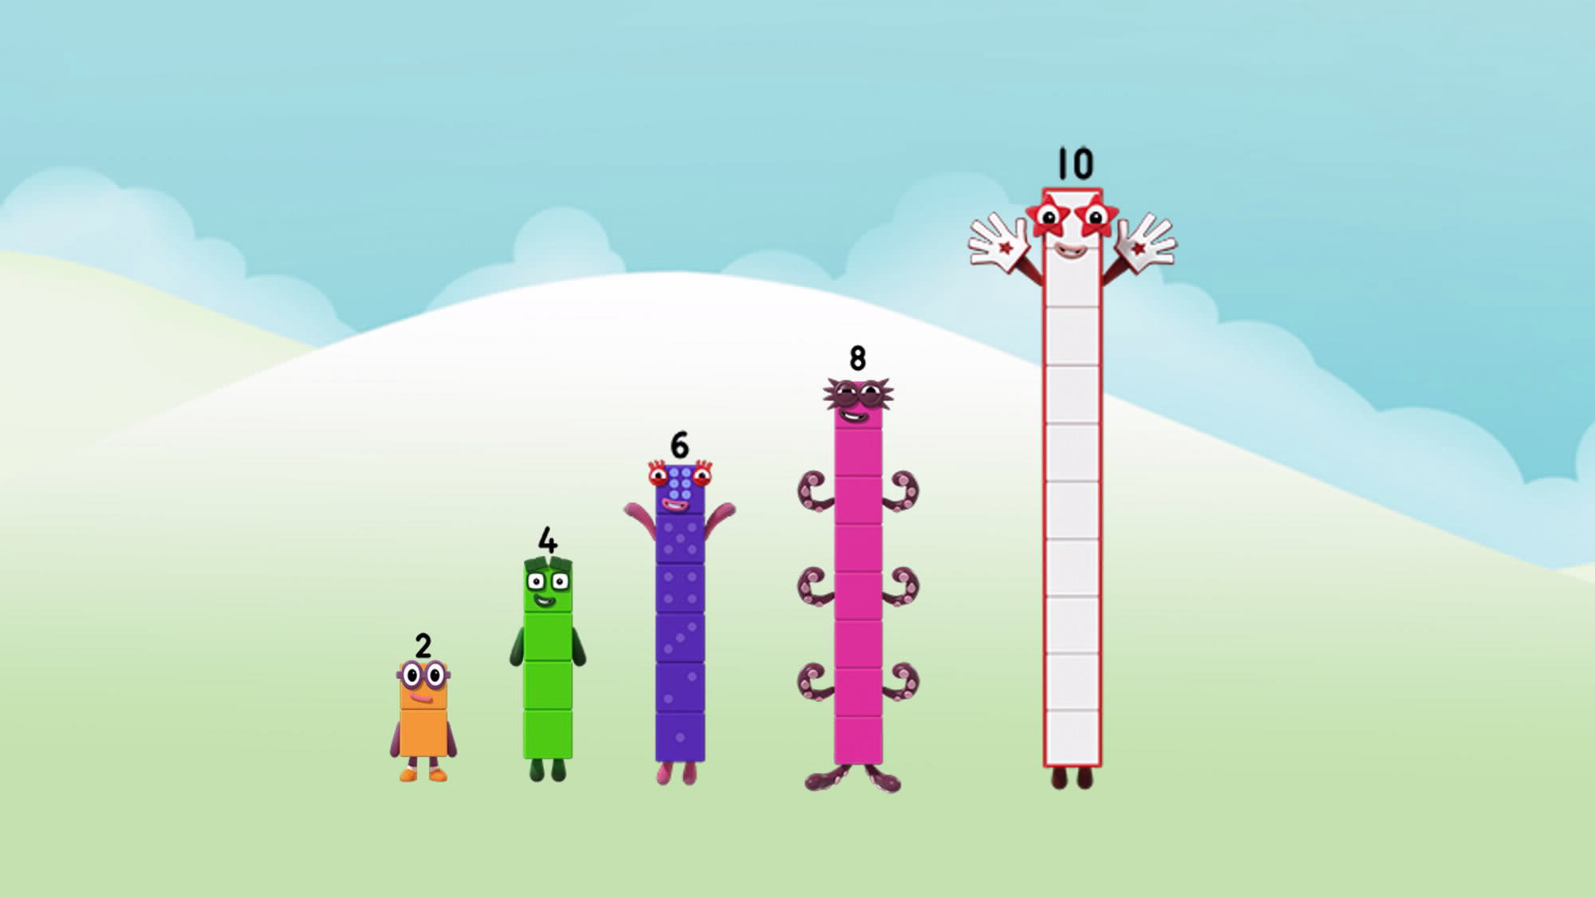
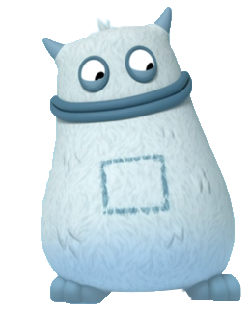
is more than .
is less than .
Images © 2017 Alphablocks Ltd. All Rights Reserved.
Notes:
How could we work out who is missing?
What do we already know? (We know 2 and 4 are first.)
What else do we know? (We know 8 and 10 are last.)
What do we notice that can help us? (The Numberblocks get bigger by two each time).
How can that help us to find Big Tum’s missing Numberblock? (If each Numberblock gets bigger by 2 and 4 is before the missing Numberblock,
then 6 must be the missing Numberblock.)

Slide 14
Who is missing?
Images © 2017 Alphablocks Ltd. All Rights Reserved.
Notes:
Use this slide to discuss how to work out who is missing using the reasoning practised in the previous slide.
Reorganise the blocks in numerical order.
Name the pattern.
Reason:
If 1 more than 5 is 6, and 1 less that 7 is 6, then 6 is the missing number.

Slide 15
Further activities for Y1
Find two missing numbers in a sequence.
Practise expressing reasoning about missing Numberblocks problems using sentences such as:
7 is more than 6, 7 is less than 8. Or 7 is o more than 6, 7 is o less
than 8.
Relate “7 is o more than 6” with 7 = o+6.
Use numerical sequences (forwards, backwards, for example, 18, 17, 16, 15, ?, 13, and muddled, for example, 20, 50, 30, 0, ?) identify missing numbers using the reasoning stems practised in the slides.

Slide 16
Learning Together in Y2

Slide 17
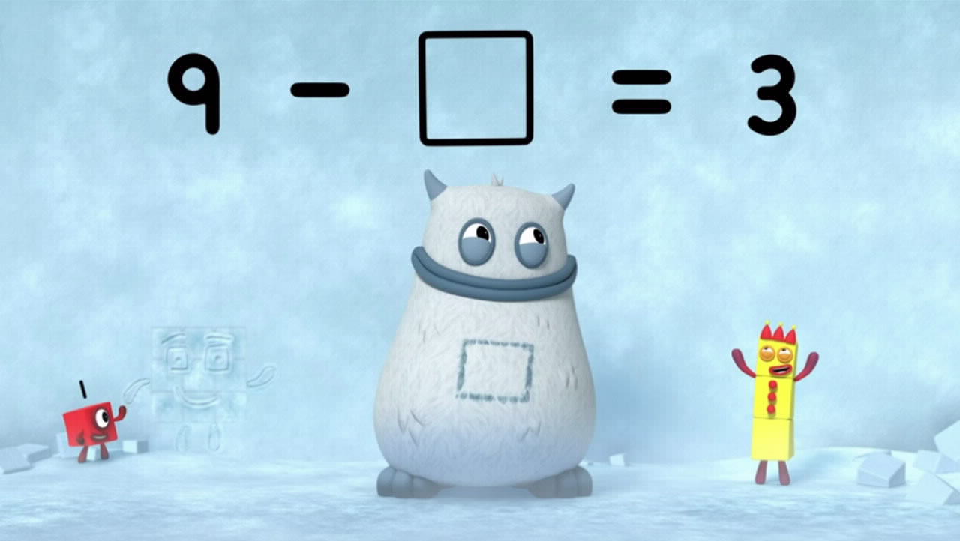
Images © 2017 Alphablocks Ltd. All Rights Reserved.
Images © 2017 Alphablocks Ltd. All Rights Reserved.
Notes:
What happened here? Can you tell the story? (Nine was here but then Big Tum ate some of Nine and only Three is left.)
I wonder who is in Big Tum’s tummy?

Slide 18
Who’s in my tum?
I am made from Six and Three.
?
Images © 2017 Alphablocks Ltd. All Rights Reserved.
Notes:
Use this slide to act out the problem.
Discuss:
Why is this the equation for the problem? (The empty box represents the missing Numberblock.)
How does the bar model represent the problem? (9 is the whole, 3 is a part, we do not know the other part.)
Can you match the parts of the equation to the different sections of the bar model, including where the unknown is?
Use the context to rehearse the stem sentences as the slide animates.

Slide 19
Nine is made from Six and Three.
Images © 2017 Alphablocks Ltd. All Rights Reserved.
Notes:
This slide abstracts the mathematics using different representations of the Numberblock story. Instead of Numberblock characters the numbers are represented with a pictorial image of interlocking cubes and a tens frame. These representations show the relationship between 9, 6, 3 in three different ways, including the abstract equation.
Throughout this slide, pause to ask What is the same / What is different? about the representations, and how what is the same, makes finding the unknown easier, that is to say it doesn’t matter which is left (the 6 or 3), we can say the part which was taken.
Pupils should have their own representations to build alongside the animations.

Slide 20
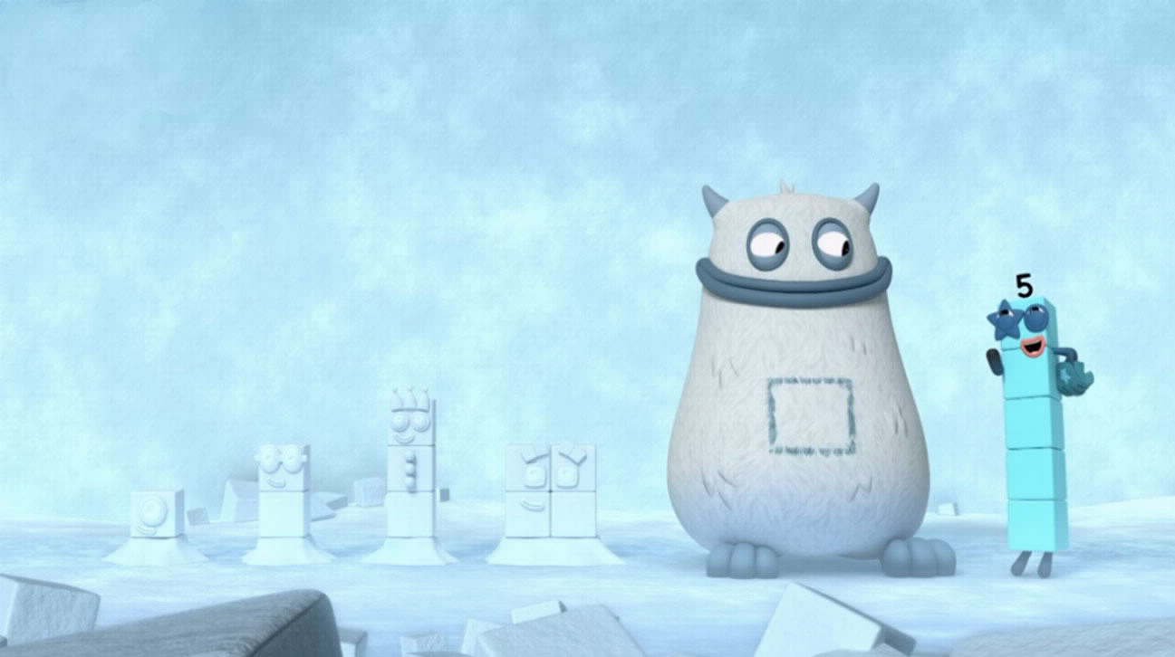
Images © 2017 Alphablocks Ltd. All Rights Reserved.
Notes:
What happened here? Can you tell the story?
1, 2, 3, 4 are missing. Big Tum tells Five that now they are all together as one Numberblock.
How can we help Five to find out which Numberblock?

Slide 21
Who’s in my tum?
Find a smart way to add these blocks?
Images © 2017 Alphablocks Ltd. All Rights Reserved.
Notes:
Use this slide to introduce the problem that the children can work on.
There are different ways to add these four numbers. Invite children to work in talk partners to find a smart way to find the total of 10. Allow time for them to explore before gathering examples and comparing strategies.
For example, 1+4=5 and 2+3=5. So, 5+5=10 OR 1+3=4; 4 + 4 = 8; 8 + 2 = 10 OR 4+3=7; 1+2=3; 7+3=10.
Ask children what they noticed, to explain their reasons for choosing their strategy, to evaluate whether it was a good strategy after they did it or whether they changed their strategy.

Slide 22
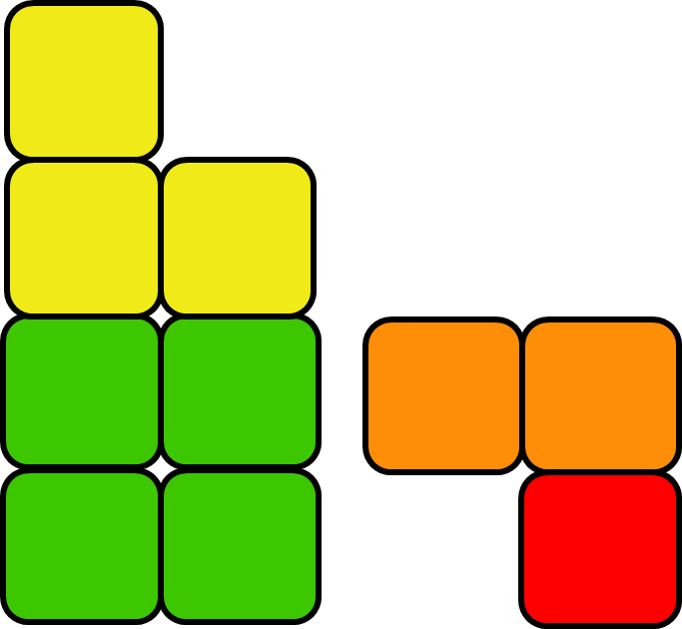
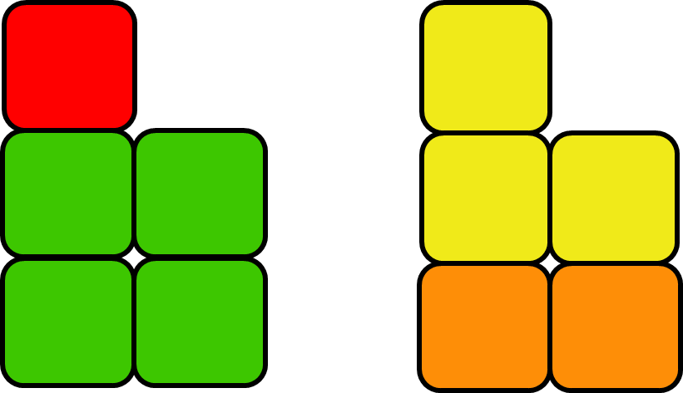
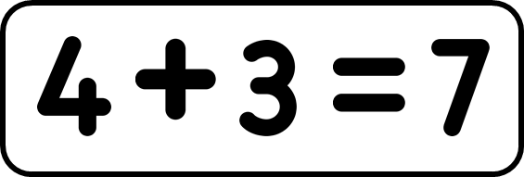
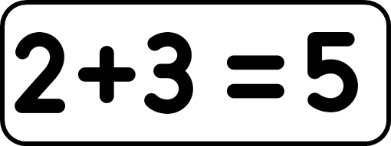
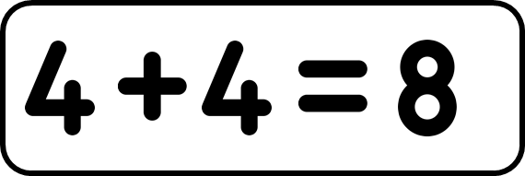
Images © 2017 Alphablocks Ltd. All Rights Reserved.
Notes:
This slide shows how to model some of the ways. Compare the pupils’ strategies with these ones. Which one do you like? Why? Which ones can help to work out the calculation more quickly? Why?
For example:
1+4=5 and 2+3=5. So, 5+5=10
1+3=4; 4 + 4 = 8; 8 + 2 = 10
4+3=7; 1+2=3; 7+3=10.

Slide 23
Further activities for Y2
Using a known fact to explain reasoning to find a missing number:
– If 8 + 3 = 11, and 3 is left, then o was taken.
Given a missing-number sentence, show what it means using different representations: build it, draw it, say it, write it.
Given a missing-number sentence, suggest a known fact which can be used to help to identify the missing number.
Investigate how the representation of an equation with an unknown is represented when the unknown is in different parts of the equation. For example, using ‘?’ to represent the unknown in a bar model.
Match word problems with unknowns in different positions to the equation and/or bar models that represents the problem.
Build on slides 21 and 22 to find smart ways to solve 1+2+3+4+5.

