Slide 1
2.25 Using compensation to calculate
Representations | Year 6
Multiplication and Division

Slide 2
How to use this presentation
You can find the teacher guide 2.25 Using compensation to calculate by following the link below.

Slide 3
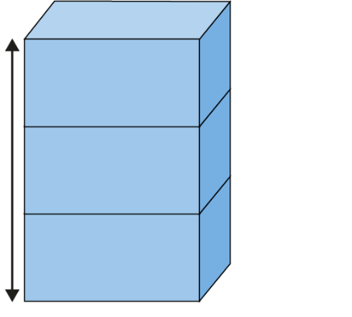
2.25 Compensation Step 1:1
20 cm × 3
Notes:
Pip is stacking boxes that are 20 cm × 20 cm × 40 cm.
When she stacks three boxes like this, the height of all three is 60 cm.

Slide 4
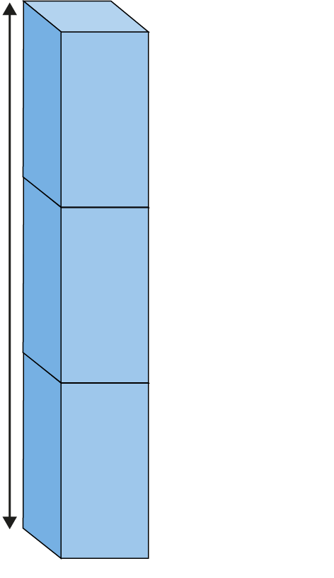
2.25 Compensation Step 1:1
20 cm × 3
40 cm × 3
Notes:
When she stacks the same three boxes like this, the height of all three is 120 cm.

Slide 5
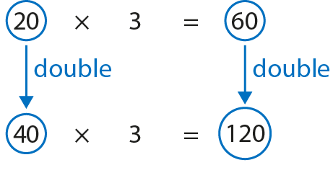
2.25 Compensation Step 1:1
20 cm × 3
40 cm × 3
Notes:
If I double one factor, I must double the product.
If I multiply one factor by two, I must multiply the product by two.

Slide 6
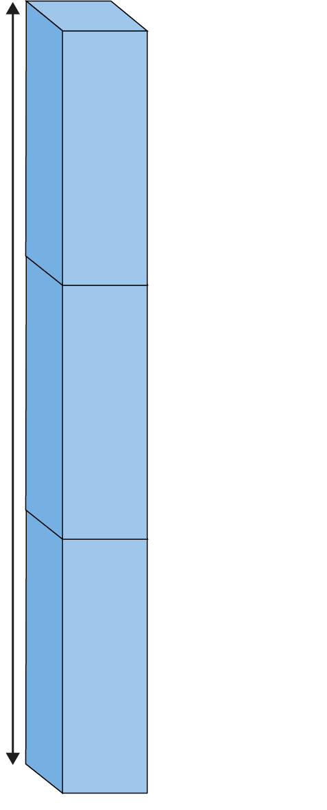
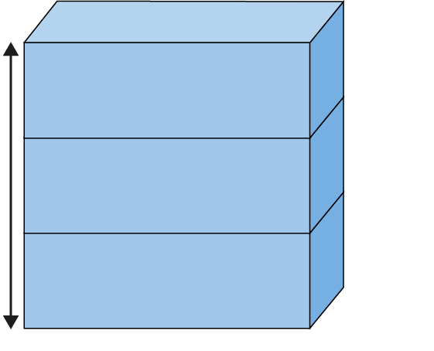
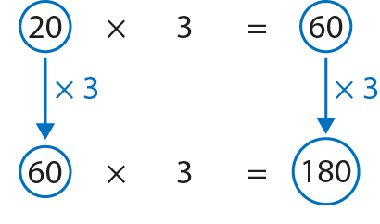
2.25 Compensation Step 1:2
20 cm × 3
60 cm × 3
Notes:
Now Pip is stacking boxes that are 20 cm × 20 cm × 60 cm.
If I multiply one factor by three, I must multiply the product by three.

Slide 7
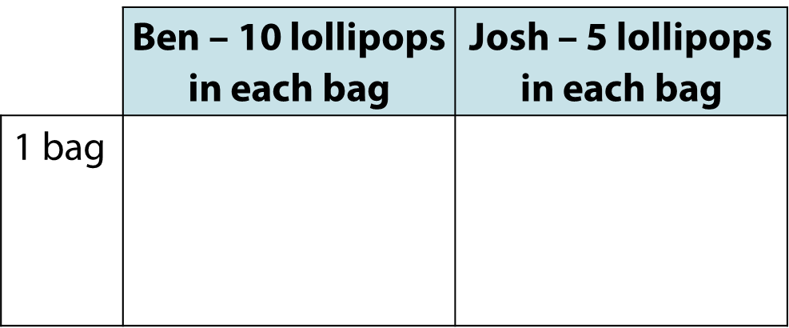
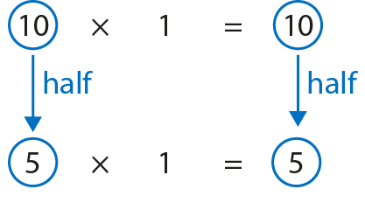
2.25 Compensation Step 1:3
Notes:
If I halve one factor, I must halve the product.
If I divide one factor by two, I must divide the product by two.

Slide 8
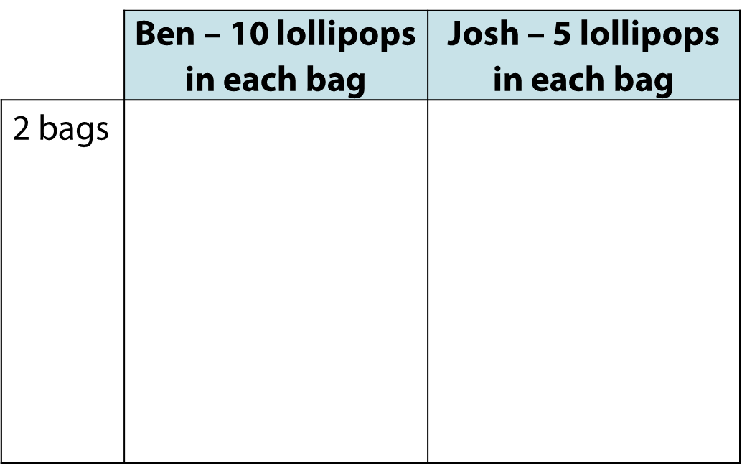
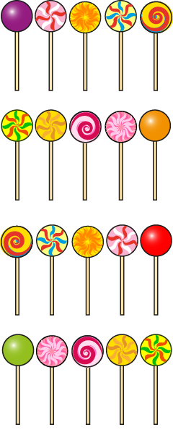
2.25 Compensation Step 1:3
Notes:
If I halve one factor, the product will be half the size.
If I divide one factor by two, I must divide the product by two.

Slide 9
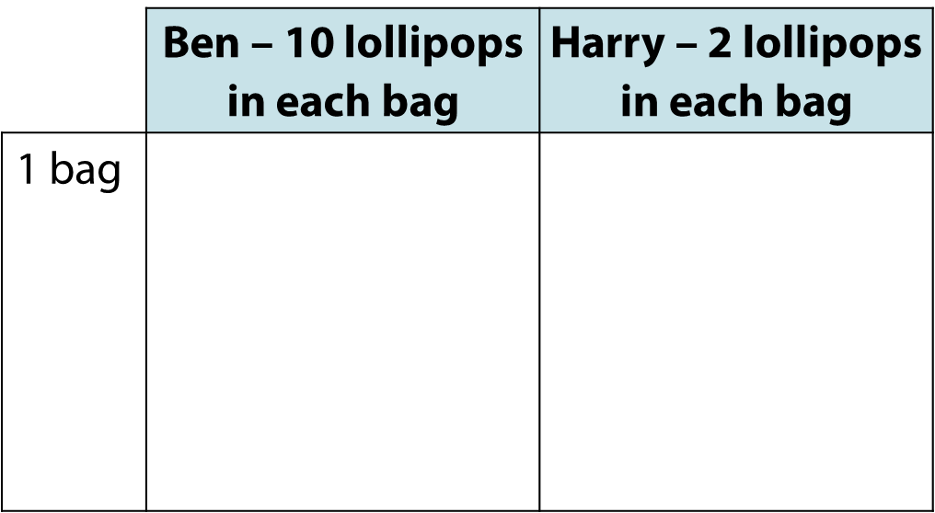
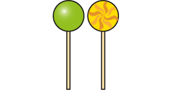
2.25 Compensation Step 1:3
Notes:
If I divide one factor by five, I must divide the product by five.

Slide 10
2.25 Compensation Step 1:5
42
×
5
=
210
42
×
10
=
420
Notes:
If I double one factor, the problem becomes 42 × 10.
42 × 10 = 420
Now halve the product to find the answer to the original problem.
420 ÷ 2 = 210
42 × 5 = 210

Slide 11
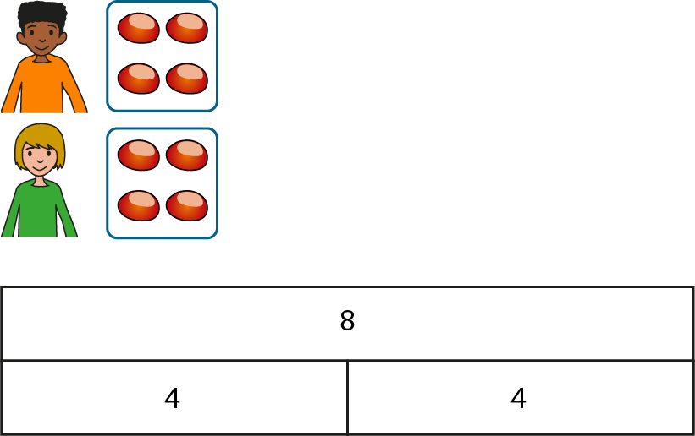
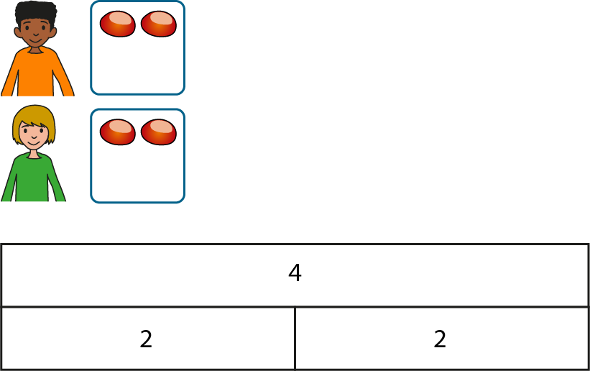
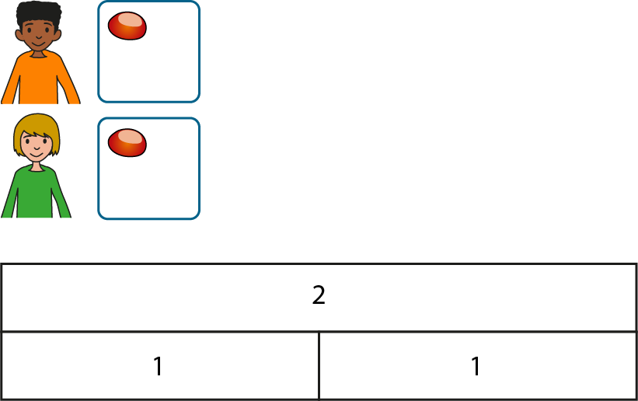
2.25 Compensation Step 2:1
8 ÷ 2 = 4
4 ÷ 2 = 2
2 ÷ 2 = 1

Slide 12
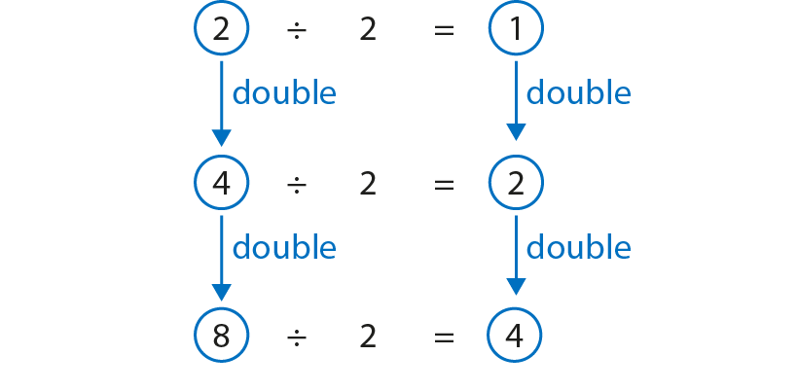
2.25 Compensation Step 2:1
Notes:
If I double the dividend and keep the divisor the same, I must double the quotient.
If I multiply the dividend by two and keep the divisor the same, I must multiply the quotient by two.

Slide 13
2.25 Compensation Step 2:2
3
1
1
1
3 ÷ 3 = 1
12
4
4
4
12 ÷ 3 = 4
Notes:
If I multiply the dividend by four and keep the divisor the same, I must multiply the quotient by four.

Slide 14
2.25 Compensation Step 2:2
5
5
5 ÷ 5 = 1
15
5
5
5
15 ÷ 5 = 3
Notes:
If I multiply the dividend by three and keep the divisor the same, I must multiply the quotient by three.

Slide 15
2.25 Compensation Step 2:2
Notes:
If I multiply the dividend by four and keep the divisor the same, I must multiply the quotient by four.

Slide 16
2.25 Compensation Step 2:3
Notes:
If I divide the dividend by two and keep the divisor the same, I must divide the quotient by two.

Slide 17
2.25 Compensation Step 2:3
Notes:
If I divide the dividend by three and keep the divisor the same, I must divide the quotient by three.

Slide 18
2.25 Compensation Step 2:3
Notes:
If I divide the dividend by five and keep the divisor the same, I must divide the quotient by five.

Slide 19
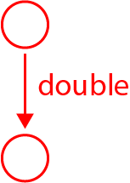
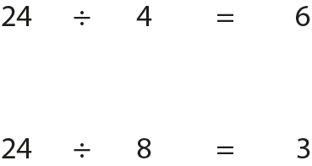
2.25 Compensation Step 3:1
Notes:
If I double the divisor and keep the dividend the same, I must halve the quotient.
If I multiply the divisor by two and keep the dividend the same, I must divide the quotient by two.

Slide 20
2.25 Compensation Step 3:1
Notes:
If I multiply the divisor by three and keep the dividend the same, I must divide the quotient by three.

Slide 21
2.25 Compensation Step 3:1
Notes:
If I multiply the divisor by four and keep the dividend the same, I must divide the quotient by four.

Slide 22
2.25 Compensation Step 3:2
Notes:
If I halve the divisor and keep the dividend the same, I must double the quotient.
If I divide the divisor by two and keep the dividend the same, I must multiply the quotient by two.

Slide 23
2.25 Compensation Step 3:2
Notes:
If I divide the divisor by three and keep the dividend the same, I must multiply the quotient by three.

Slide 24
2.25 Compensation Step 3:2
Notes:
If I divide the divisor by five and keep the dividend the same, I must multiply the quotient by five.

Slide 25
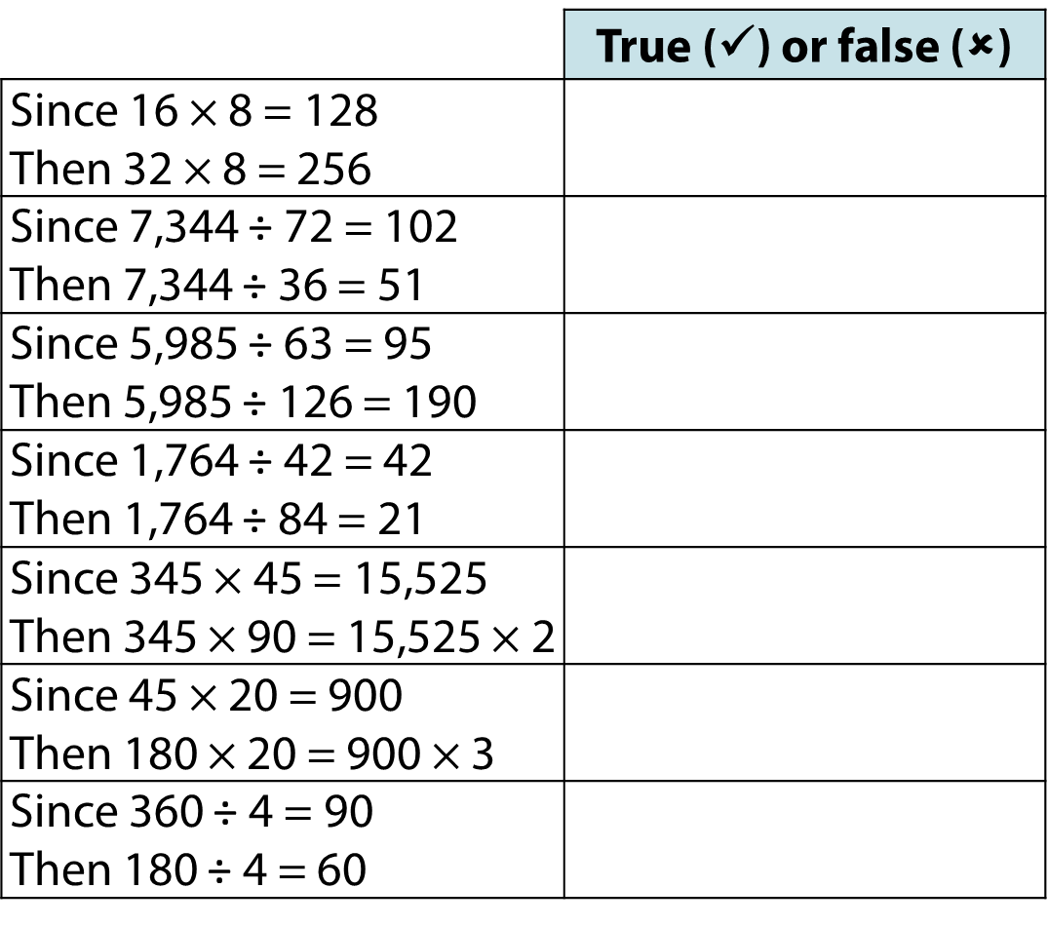
2.25 Compensation Step 3:5

