Slide 1
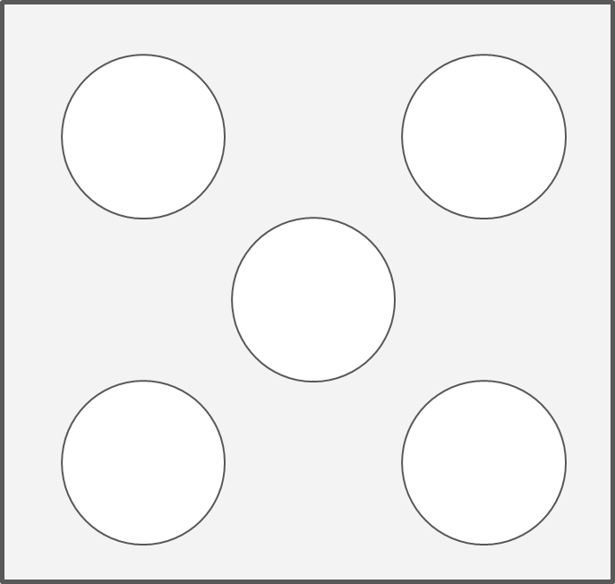
6 as 3 and 3
Mastering Number 2021/22 ncetm.org.uk

Slide 2
6 as 5 and 1
Mastering Number 2021/22 ncetm.org.uk

Slide 3
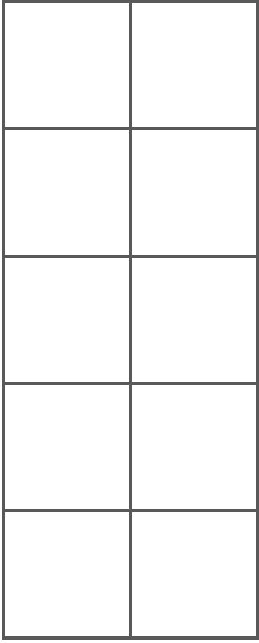
Double seven

Slide 4
Double 8

Slide 5
Double seven on a rekenrek

