Slide 1
Lesson materials (and how they were presented) used by Shanghai teacher at Shanghai Huangpu District No.1 Central Primary School on Wednesday 9
November 2016

Slide 2
The teacher demonstrated the sum 9 + 5 using
manipulatives fixed to the blackboard:
9
+
5
Underneath the teacher wrote:
1
4
9
+
1
=
10
10
+
4
=
14

Slide 3
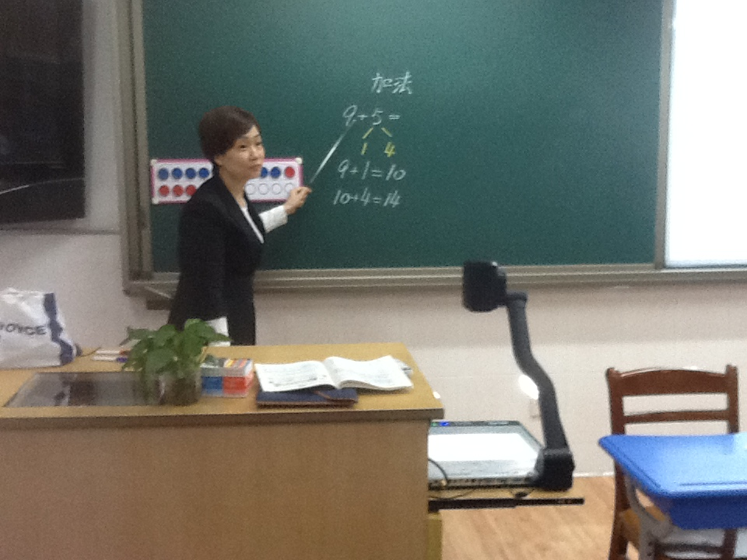

Slide 4
The teacher then explained very precisely:
First partition the 5: 1 + 4 = 5, then 9 + 1 = 10 and 10 + 4 = 14
She then asked one student to say it, in full, then another, in full, then the whole class were asked to chant it, saying the whole thing in full. She described this as rehearsing the process.
The students were then given their own manipulatives – grids and counters that matched those the teacher was using. They were asked to use their grids to demonstrate the sum. The teacher went around the class, checking what they were doing. She singled out one boy and asked him to go to the front with her to show what he had done, using a visualiser to project his grids onto the whiteboard.

Slide 5
The boy’s grids did the sum in a different way:
The teacher then wrote this on the blackboard:
She asked the class: ‘Do you agree with him?’
They tried it with their manipulatives and agreed it is correct.
9
+
5
4
5
5
+
5
=
10
+
=
14
10
4

Slide 6
The teacher then asked a pupil: ‘Why do we need to
make 10?’.
The pupil responded: ‘To help make the answer when the sum is bigger than 10.’
This was then repeated as a class question and the class chanted the response together.
Next the class was asked to find 8 + 5 using their manipulatives. (Note the variation – the 9 from the previous sum is changed to an 8, the 5 remains the same.)

Slide 7
Grid pairs such as those shown below, or other (correct)
variations on them, were produced by different pupils:
Either
or
or

Slide 8
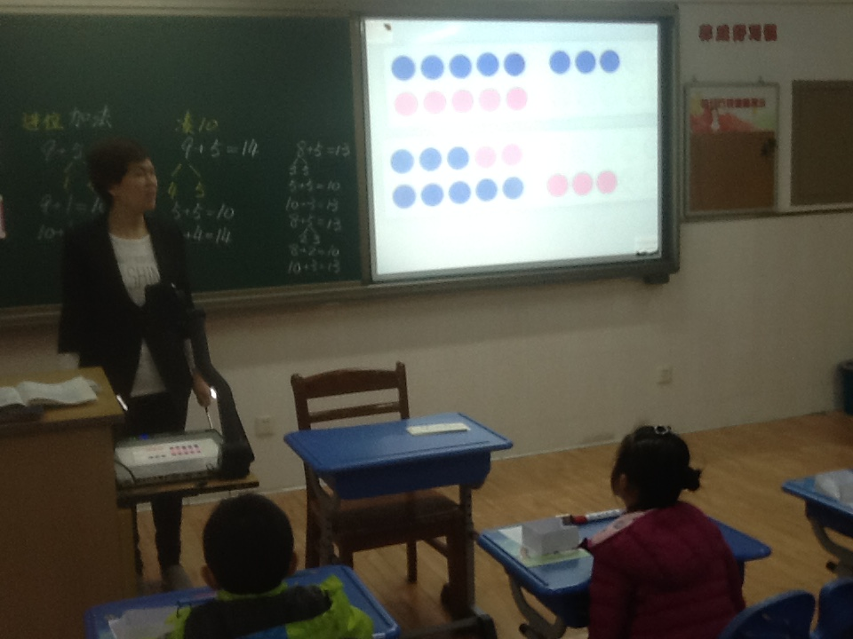

Slide 9
The teacher showed the first version using her
manipulatives at the board, then explained it very
precisely, writing the following on the blackboard:
First partition the 8: 3 + 5 = 8, then 5 + 5 = 10 and 10 + 3 = 13
The pupils were asked to say this together as a class, then encouraged to work in pairs to say it to each other, using their solutions
8
+
5
5
3
5
+
5
=
10
10
+
3
=
13

Slide 10
The teacher then chose a solution from a pupil who had done the
calculation by partitioning the 5 instead of the 8, and projected this
solution onto the whiteboard using a visualiser:
The pupils were then asked to then stand up, as a whole class, and chant the method and the solution in full:
First partition the 5: 2 + 3 = 5, then 8 + 2 = 10 and 10 + 3 = 13
8
+
5
2
3
8
+
2
=
10
+
=
13
10
3

Slide 11
The teacher then handed out a worksheet with 10s grids
printed on it that the pupils could write in, together with
questions. (Note this is moving from the concrete manipulatives to a more abstract diagram.)
The first question asked the pupils to calculate 7 + 6 (Note the variation, the answer is the same as the previous example, 8 + 5), using the 10s grids. The pupils worked on this and again the teacher selected a solution to project using the visualiser. The whole class was then asked to chant the solution and answer in full:
First partition the 6: 3 + 3 = 6, then 7 + 3 = 10 and 10 + 3 = 13
The pupils stand up as a class and chant the method and the solution in full:
First partition the 5: 2 + 3 = 5, then 8 + 2 = 10 and 10 + 3 = 13

Slide 12
The teacher then asked: Any different opinions?
A pupil offered an alternative solution, which the teacher projected using the visualiser. The pupil was then asked to explain, and did so in full:
First partition the 7: 4 + 3 = 7, then 6 + 4 = 10 and 10 + 3 = 13
Finally, the pupils were asked to do one more question on the worksheet: 2 + 9.
The pupils then handed in their worksheets and the lesson ended.
The total lesson time was 35 minutes.
The pupils stand up as a class and chant the method and the solution in full:
First partition the 5: 2 + 3 = 5, then 8 + 2 = 10 and 10 + 3 = 13

Slide 13
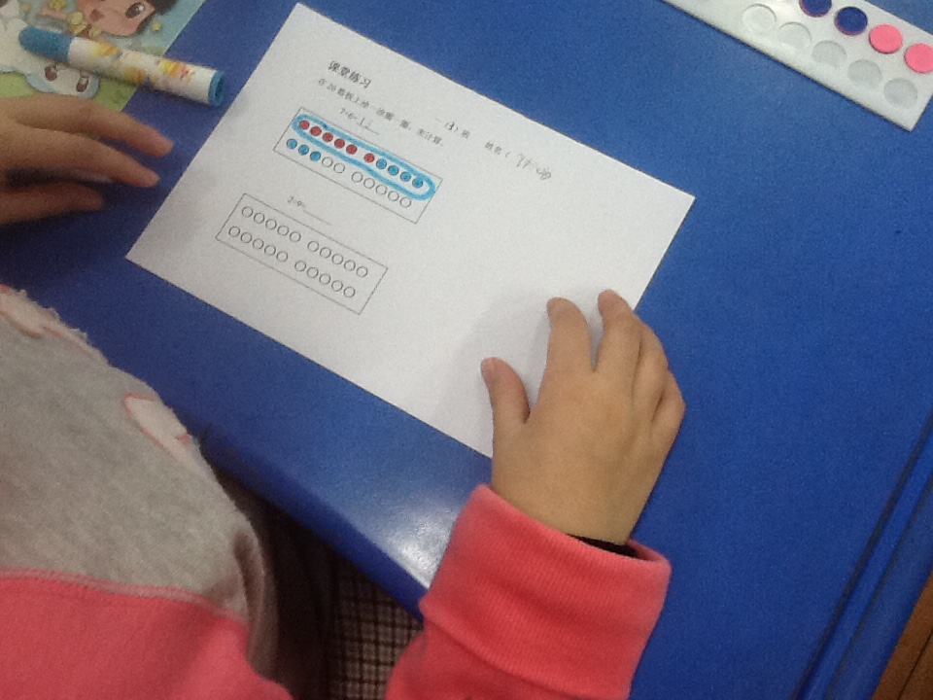
The children were asked to ring the ten on their grid solutions. Making ten was the key part of the lesson.

